Slide 1

Officials Training Meeting – Fall 2019

Slide 2
Uniform & Pre-game
Section 1

Slide 3
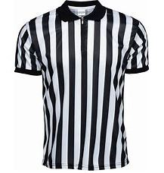
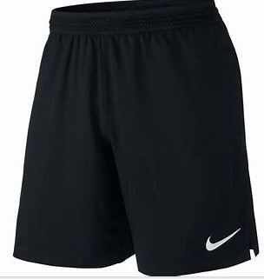
Uniform
We supply:
Referee Jersey
Yellow Flag
You supply:
Black Shorts
Whistle
Hat/Sunglasses

Slide 4
Pre-Game
Equipment Checks
Mouthguards
No pockets/taped pockets
Tucked in shirts
No metal cleats
Pull flags
Coin toss will be performed at center of field

Slide 5
Positional Mechanics
Section 2

Slide 6
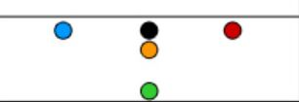
2-Man Positional Mechanics
Line Judge
Pre-snap position: LOS
  Keep the play clock, count the offense, ensure offense and defense are onsides, watch for illegal shifts
Live-ball position: Hold LOS
  Count 7 (or 5), watch for illegal forward pass, watch for illegal run by quarterback (rusher didn’t cross), watch for roughing the passer
  Upon dead balls, spot ball on your half of the field, Field Judge will move the bags

Slide 7
2-Man Positional Mechanics
Field Judge
Pre-snap position: seven yards off LOS (rush bag)
  Count the defense, note eligible rushers (players lined up behind rush bag at the snap), determine if rusher has clear line to the quarterback
Live-ball position: flow with the play (be the deepest)
  Ensure rush is legal, watch for impeding the rusher, watch receivers to rule on illegal contact, holding, and OPI/DPI
  Upon dead balls, spot the ball on your half of the field or on plays deep down field, Line Judge will move the bags

Slide 8
3-Man Positional Mechanics
Referee (or Trainees)
Pre-snap position: 2 yards back and 5 yards off quarterback
  If Trainee: observe formation
  If Referee: keep the play clock (LJ no longer does), watch for illegal shifts
Live-ball position: 2 steps back from original position
  If Trainee: observe play. Upon dead balls, move the bags
  If Referee: count 7 (LJ no longer does), watch for roughing the passer (LJ no longer does), determine if rusher has clear line to quarterback, watch for impeding the rusher (FJ no longer does). Upon dead balls, move the bags

Slide 9
Timing & Overtime
Section 3

Slide 10
Standard Timing
2 20-minute halves
Clock will stop within the last two minutes of each half on dead balls
  Dead ball: incomplete pass, out of bounds, fumble, change of possession, scoring play
  Extra points are untimed downs
Play clock is 30 seconds between each play (begins at ready for play)
1-time outs per half

Slide 11
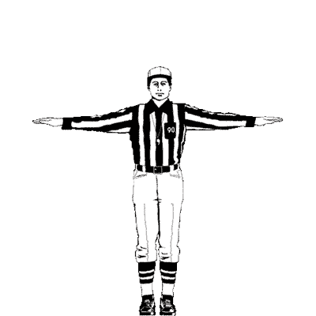
Incomplete Pass
Stops clock

Slide 12
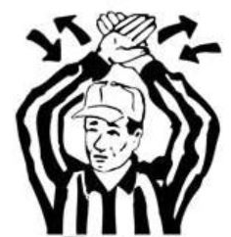
Stop Clock
Time out, out of bounds (within 2 minutes), fumble (within 2 minutes), change of possession (within 2 minutes)

Slide 13
Overtime Rules
Visiting team calls the toss
Ball will be placed at the 12-yard line (2-point conversion line)
  4 downs to score
  Upon scoring, each team gets the chance to go for 1 or 2
  No time outs, no game clock. 30 second play clock remains.
Each time gets the chance to possess the ball
  A defensive score on the first team’s drive will end the game
For regular season games, after 3 overtimes, the game will be pronounced a tie
  For playoff games, a winner will be determined despite number of overtime rounds

Slide 14
Scoring
Section 4

Slide 15
Scoring
Touchdown – 6 points
  Defined as the player’s front foot breaking the plane of the goal-line
Extra Points
  1 Point – 5-yard line (no run zone)
  2 Points – 12-yard line
  Once a coach has decided which extra point he will attempt, any change to this decision will require a charged time out
No Run Zone
  5 yards before each line to gain

Slide 16
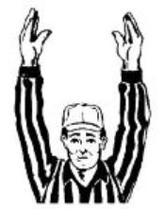
Touchdown
Also successful extra point

Slide 17
Scoring
Safety – 2 Points
  Defined as the player’s leading foot (depends on their direction) being entirely in their own end zone at the time the flag is pulled/player steps out of bounds/player is pronounced down/fumble occurs

Slide 18
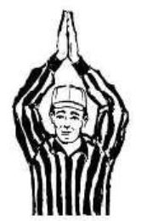
Safety
Worth 2 points

Slide 19
Scoring
Scrimmage Mode
  Upon the scoring delta reaching 28 points, the losing team will be offered scrimmage mode. Scrimmage mode includes:
    3 sets of consecutive offensive downs (if the losing team gains a first down, this will be treated as 4 sets)
    Upon the losing team scoring, the game will be over
    If they do not score at the end of 3 sets of downs, the game will be over
    All turnovers will be blown dead and the ball will be returned to the losing team
  In a playoff game, a 28-point delta will be treated as mercy rule and the game will be over

Slide 20
The Passing Game
Section 5

Slide 21
Forward Passes
All passes must be forward and beyond the LOS
  Forward passes behind the line of scrimmage, whether they are received or not, are considered an illegal forward pass
  Any forward pass thrown while the passer is beyond the LOS is an illegal forward pass
  Illegal Forward Pass – 5-yard penalty, loss of down
The passer has 7 seconds (5 seconds in 13-14) to release the ball, or the play will be blown dead
Shovel passes are allowed

Slide 22
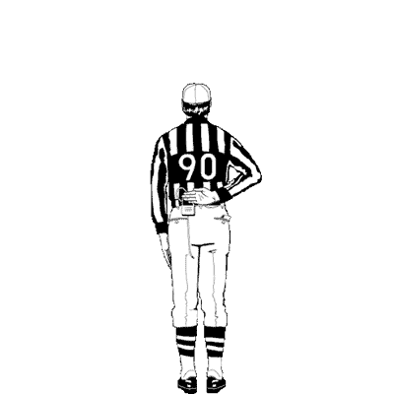
Illegal Forward Pass
5-yard penalty, loss of down

Slide 23
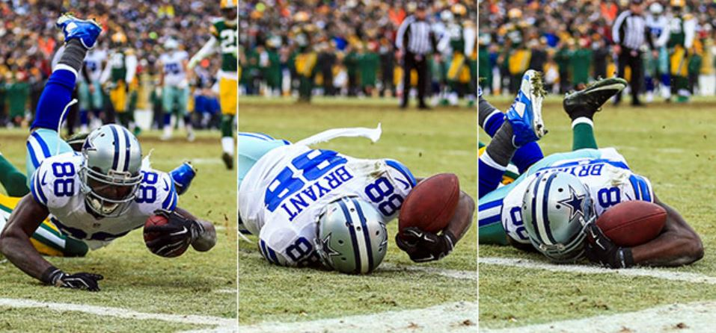
Receiving
All players are eligible to receive a pass
A legal catch is defined as a player possessing a forward pass, beyond the line of scrimmage. Caveats:
  Player must have at least 1 foot in bounds
  If player begins process of the catch while in the air, they must survive the ground with possession
  In the case of simultaneous possession by offense and defense, possession is awarded to the offense

Slide 24
Coaches
Section 6

Slide 25
Coaches
Coaches must be on the sidelines at all times
  Exceptions: 7-8 division, 5-6 division. 1 coach on the field, away from the play
The Head Coach will be the one who will communicate with referees at all times
  Head Coaches may ask for rule clarification, ask about a specific call, politely discuss rules with officials
  Any other sideline personnel do not have these same privileges with officials
What we do not accept from coaches (or any sideline personnel):
Swearing/offensive language
Personal attacks (verbal and physical)
Taunting

Slide 26
Unsportsmanlike Conduct
10-yard foul from LOS. Loss of down or automatic first down

Slide 27
Coaches
DO:
Stop the game at any time if a sideline is getting out of control and bring over Mike
  Head Coaches may, at any time, call a time out to bring Mike over
Be diplomatic in responses to coaches when discussing rules
DON’T:
Engage in arguing with coaches
View any videos of plays that coaches or parents attempt to show you

Slide 28
Offensive Fouls
Section 7

Slide 29
Offensive Fouls
Spot Fouls:
Blocking – 10 yards, loss of down
  Philosophy: any offensive player that is in motion and materially impeding defenders in relation to the ball carrier
Charging – 10 yards, loss of down
  Philosophy: any offensive player that makes a clear and obvious attempt to advance the ball by contacting a defender instead of avoiding them
Flag guarding – 10 yards, loss of down
  Philosophy: any motion made by the ball carrier that directly and physically blocks the defender’s hands from pulling their flag

Slide 30
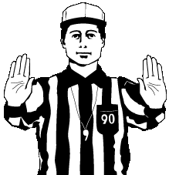
Blocking
10-yard penalty, loss of down

Slide 31
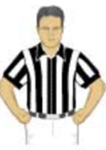
Charging
10-yard penalty, loss of down

Slide 32

Flag Guarding
10-yard penalty, loss of down

Slide 33
Offensive Fouls
Unnecessary Roughness – 10-yard penalty, loss of down
  Philosophy: any sort of physical contact between players that endangers player safety
Unsportsmanlike Conduct – 10-yard penalty, loss of down
  Philosophy: any sort of non-physical actions by a player that is deemed to be outside of common sportsmanship (taunting, offensive language, excessive celebration)
False Start – Stops the play, 5-yard penalty
  Differs from offsides; offsides will not stop the play and will result in loss of down

Slide 34
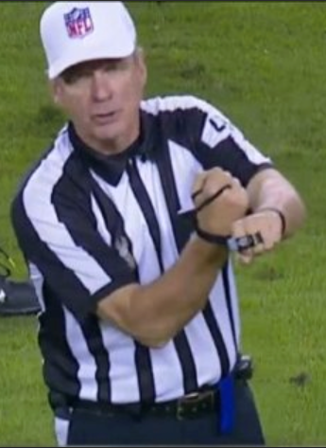
Unnecessary Roughness
10-yard penalty, loss of down

Slide 35
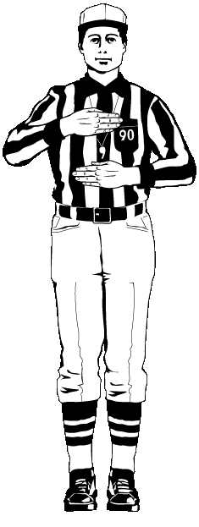
False Start
5-yard penalty, not a loss of down

Slide 36
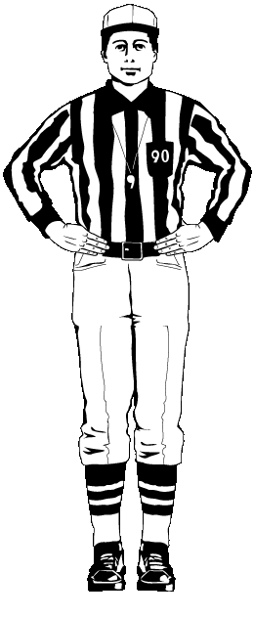
Offsides
5-yard penalty, loss of down

Slide 37
Offensive Fouls
Illegal Motion – 5-yard penalty, loss of down
  Philosophy: 2 players in motion at the start of the snap OR 2 players in motion that did not get set for a period of at least one second prior to the snap
Delay of Game – Stops the play, 5-yard penalty, not a loss of down
Impeding the Rusher – 5-yard penalty, loss of down
  Philosophy: any material obstruction of a rusher who begins the play with a clear line to the quarterback (does not have to be physical obstruction)
    Exceptions: not a clear line to quarterback, quarterback rolls out (changes the originally clear line)

Slide 38
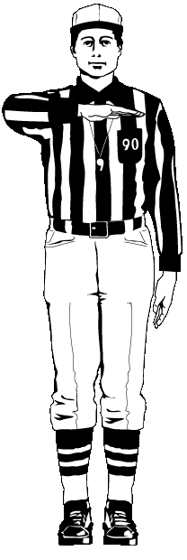
Illegal Motion
5-yard penalty, loss of down

Slide 39
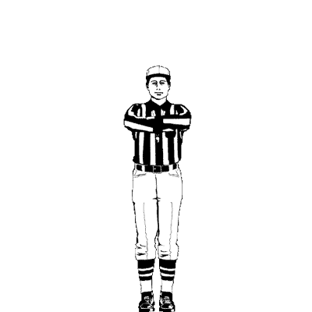
Delay of Game
5-yard penalty, not a loss of down

Slide 40
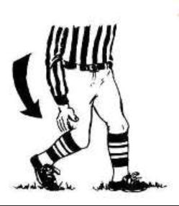
Impeding the Rusher
5-yard penalty, loss of down

Slide 41
Defensive Fouls
Section 8

Slide 42
Defensive Fouls
Spot Fouls
Holding – 5-yard penalty, automatic first down
  Philosophy: any grasp that a defender has on the ball-carrier (or ball-carrier’s uniform) that restricts the ball carrier from advancing the ball
    Judgement call – try to limit calling holding on a “grab and release”
Illegal Contact – 5-yard penalty, automatic first down
  Philosophy: any excessive contact that the defender makes with the receiver prior to the ball being in the air

Slide 43
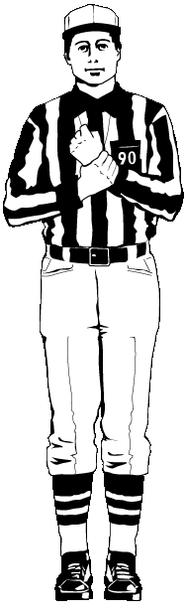
Holding
5-yard penalty, automatic first down

Slide 44
Illegal Contact
5-yard penalty, automatic first down

Slide 45
Defensive Fouls
Unnecessary Roughness – 10-yard penalty, automatic first down
  Philosophy: any sort of physical contact between players that endangers player safety
Unsportsmanlike Conduct – 10-yard penalty, automatic first down
  Philosophy: any sort of non-physical actions by a player that is deemed to be outside of common sportsmanship (taunting, offensive language, excessive celebration)
Offsides – 5-yard penalty, automatic first down
Tackling – 10-yard penalty, automatic first down
  Philosophy: any physical contact by a defender that brings down the ball carrier that the referee deems to be non-incidental and endangering the safety of the ball-carrier

Slide 46
Defensive Fouls
Illegal Rush – 5-yard penalty, automatic first down
  Any defender who crosses the line of scrimmage before the ball is handed off that did not line up behind the rush bag
Illegal Flag Pull – 5-yard penalty, automatic first down
  Any defender who pulls a receiver’s flag prior to them possessing the ball
Roughing the Passer – 10-yard penalty, automatic first down
  Philosophy: any egregious contact to the quarterback by the defender that endangers quarterback safety.
    Additional note: quarterback is entitled to the follow through with his arm upon throwing the ball. Any contact with the quarterback’s arm is considered RTP.

Slide 47
Illegal Rush
5-yard penalty, automatic first down

Slide 48
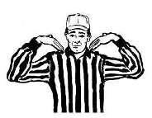
Illegal Flag Pull
5-yard penalty, automatic first down

Slide 49
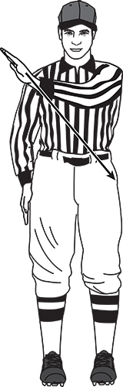
Roughing the Passer
10-yard penalty, automatic first down

Slide 50
Pass Interference
Section 9

Slide 51
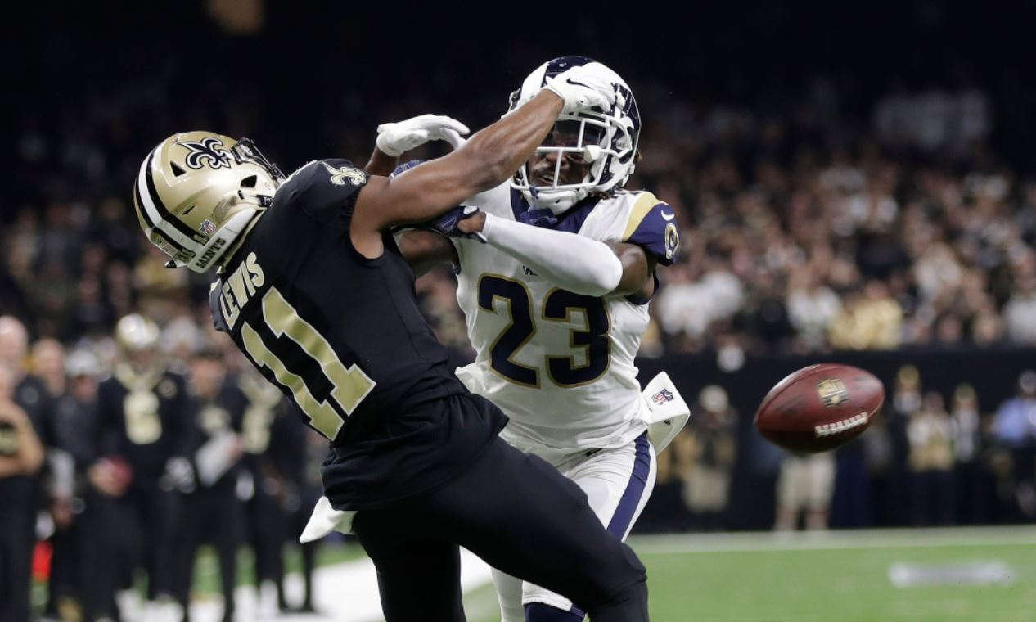
Defensive Pass Interference (DPI)
Spot Foul, automatic first down
Six categories of DPI
  Armbar
  Playing through the back
  Hold and restrict
  Hook and grab
  Cutoff
  Not playing the ball
If it’s not one of the six, it’s not DPI!

Slide 52
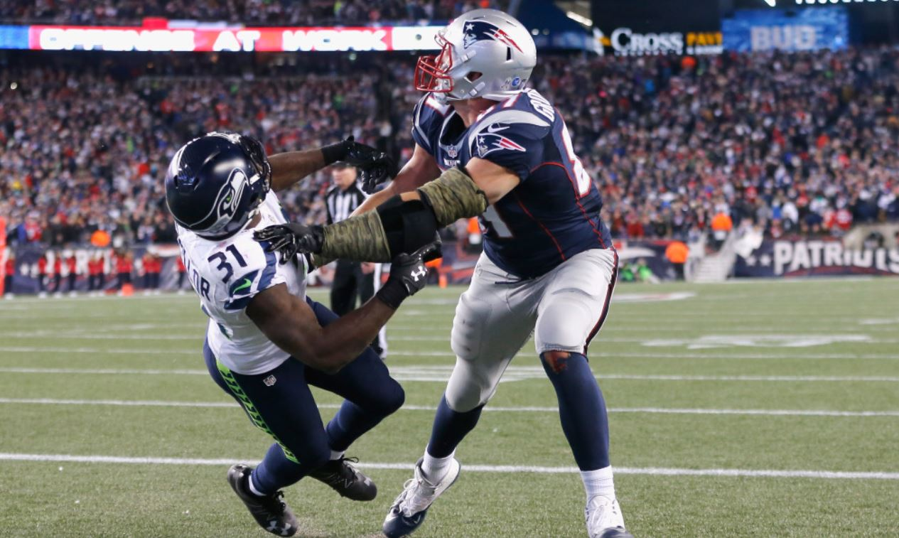
Offensive Pass Interference (OPI)
10-yard penalty, loss of down
Five categories of OPI
  Push off
  Armbar
  Playing through the back
  Hold and restrict
  Not playing the ball
If it’s not one of the five, it’s not OPI!

Slide 53
Pass Interference
DPI: Spot foul, automatic first down
OPI: 10-yard penalty, loss of down

Slide 54
Officials Training Meeting – Fall 2019

