Slide 1

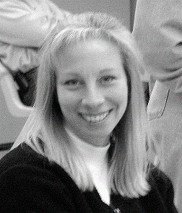
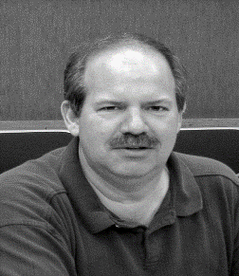
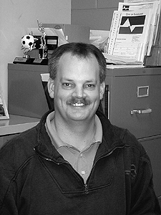
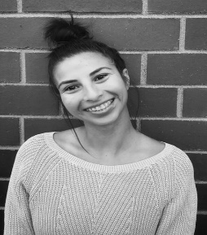
Youth Sports Coach Orientation
Athletic Team
Kim Miller
Senior Athletic Supervisor
970.962.2437
Kim.Miller@Cityofloveland.org
Adult & Youth Tennis
Gymnastics
Youth In-Line Hockey
Youth Lacrosse
Allan Coseo
Athletic Coordinator
970.962.2444
Allan.Coseo@Cityofloveland.org
Adult & Youth Softball
Adult & Youth Volleyball
Adult Basketball
Adult Kickball
Dana Redford
Athletic Coordinator
970.962.2450
Dana.Redford@Cityofloveland.org
Youth Baseball & T-Ball
Youth Basketball
Youth Flag Football
Cornhole
Savannah Garcia
Athletic Specialist
970.962.2445
Savannah.Garcia@Cityofloveland.org
Adult & Youth Soccer
Volunteer Program

Slide 2
Athletic Philosophy
The City of Loveland Parks and Recreation Department provides quality Youth Athletics programs that promote skill development, equal participation, sportsmanship, fun, and friendly competition in a positive, safe, and recreational setting.
Objectives:
Provide opportunities to develop life skills through instruction, good sportsmanship and teamwork.
Supply outlets for physical activity and skill development for all socio-economic populations.
Administer and adhere appropriate safety standards for the protection of all participants.
Create a fun and positive environment to enhance the enjoyment and overall experience for the participant.

Slide 3
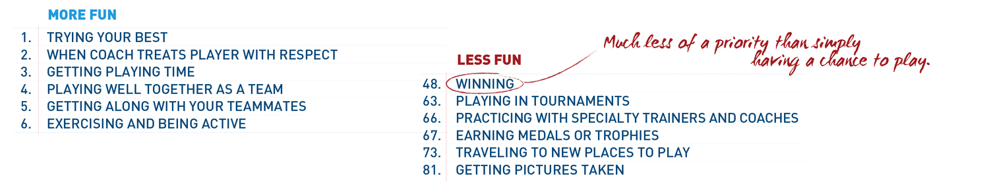
Our Leagues are Recreational
According to NAYS (National Alliance of Youth Sports) boys and girls aged 10 to 12 were asked why they played sports. The top 5 answers included…
1. To have fun.
2. To do something I’m good at.
3. To improve my skills.
4. To stay in shape.
5. To get exercise.
https://www.youtube.com/watch?reload=9&v=vIys-Mgidpg

Slide 4
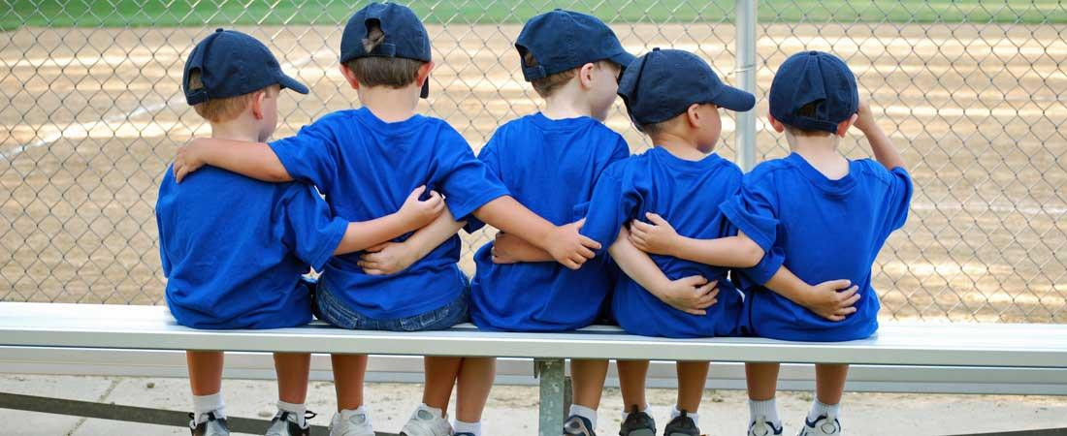
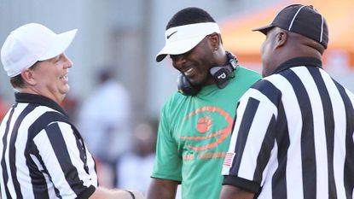
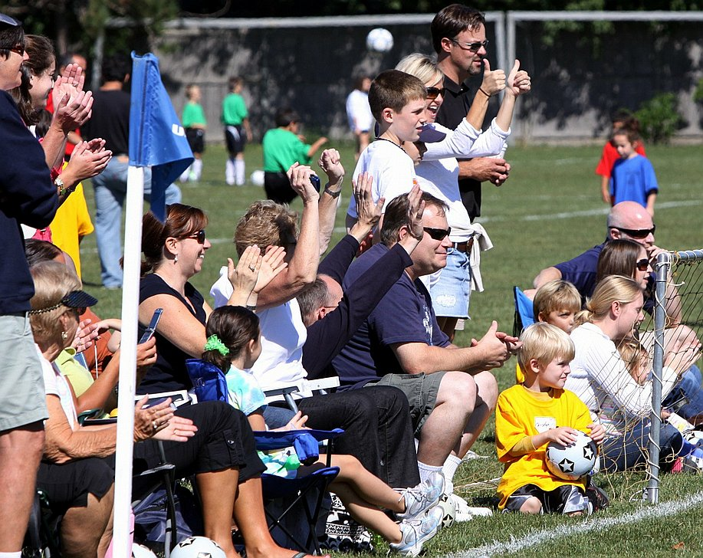
Emphasis on Sportsmanship
Sportsmanship is not…
https://www.youtube.com/watch?v=fpxPstb2DAU&t=72s
How can we create great sportsmanship?
Create a positive environment
Equal pay, equal play
Opportunities to play all positions
Reward players for great sportsmanship
Respect all parties involved – coaches, players, officials and parents
Most Importantly: Make it Fun!

Slide 5

Positive coaching
https://www.youtube.com/watch?v=ziheWTPDKHs

Slide 6

Coaches Expectations
Excellent Communication
  Establish a mainline of communication b/w parents, players and coordinator
Preparation
  Be to practice and games early
  Practice plans, game lineups etc.
  Get out information to parents and players
    Picture flyers, important dates etc.
Use Sports Administration as resources to help us succeed
Safety
HAVE FUN!

Slide 7


Coaching Checklist
Complete Background check!
Complete HeadsUp! Concussion training!
  Email certificate to sport specific coordinator
Contact each parent and inform them of your practice days, times, and locations at least 2 days before the first practice!
  Don’t forget to BCC!
P.A.C meeting before or after first day of practice
Contact the school in advance
Maintain roster
  If someone shows up to practice that is not on your roster have them contact the sports coordinator ASAP.
Create a practice plan prior to practice
Reach out when necessary and communicate

Slide 8
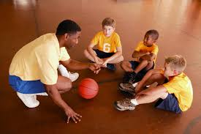
Teaching Skills
Keep practice fun and engaging
  Small groups
  No lines
  Drills that involve moving and not standing
  Be Flexible in planning practice
  Incorporate skilled games; i.e. – red light, green light; sharks and minnows etc.
  Scrimmage against other teams or own team
Progressive Sport Skills
  Provide only one tip/suggestion at a time
  Lots of reps!
Remember you’re a Mentor!

Slide 9
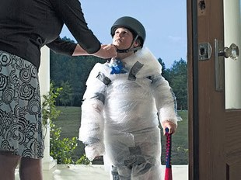
Emphasis on Safety
To ensure the safety of all participants in our sport programs, we do our best to put high emphasis on:
Background checks
Concussion training
CPR/First Aid Training
  Classes offered through The City
AED
  Located at each game site
Inspections of facility & Equipment
Incident Reports

Slide 10
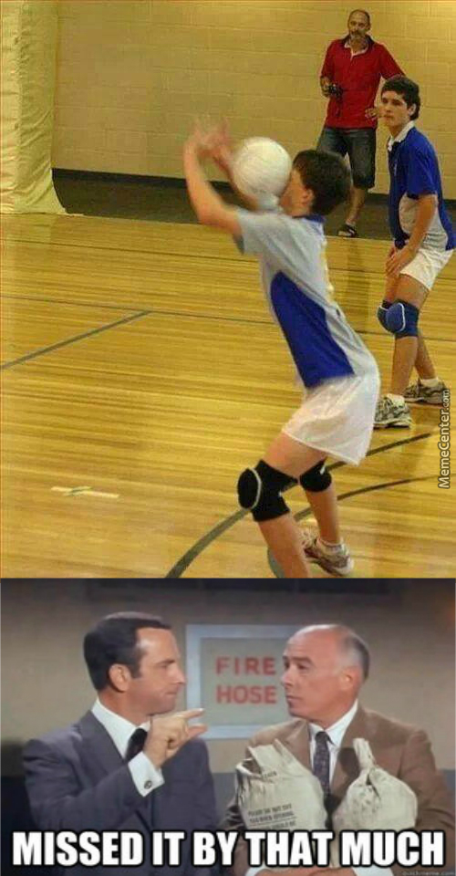

Incident Reports
Incident reports can be found in your coach packet.
Should the need arise, please fill out the report and turn in within 24 hours.
In an emergency please contact 911, and then the coordinator ASAP.

Slide 11

Mandatory Screening and Training
Background Check: American DataBank
  Conducted every 12 months on every coach and assistant coach
Concussion Training: HeadsUp
  HEADS UP Concussion in Youth Sports is a free, online course available to coaches, parents, and others helping to keep athletes safe from concussion.
  Conducted once every calendar year one every head coach and assistant coach
http://www.cdc.gov/concussion/HeadsUp/online_training.html

Slide 12
Things To Remember
Plain Sight/Never Alone with a child
Let parents/guardians know that they should not be leaving their kids at practice
Have the children use the buddy system
No jewelry or casts
H2O
Communication is key – i.e. – cancelled practice, late start etc.
Be present
  No cell phones
  Show up on time
  Have a practice plan
Be a role model
Have Fun!

Slide 13
Loveland Recreation Assistance Programs
Loveland Parks & Recreation offers two:
  Low Income Assistance (Reduced Fee)
  Youth Scholarship Program
Low Income Assistance
  Applicants must reside WITHIN Loveland city limits – all participants, no exceptions
  Must apply at one of following agencies:
    House of Neighborly Services
    Loveland Housing Authority
    Project Self Sufficiency (clients only)
Youth Scholarship Program
  Gives the opportunity for youth to play or participate in multiple programs offered by the City of Loveland.
  Applications are available at local schools and service agencies (does not operate on strict income requirements)
  Applications must be received at least one week prior to the start date
  Some athletic jerseys available for those on scholarship
Know someone who is in need?
  Contact Parks and Recreation Foundation
  (970) 962-2457
  Website: http://www.cityofloveland.org/departments/parks-recreation/administration/parks-recreation-foundation

Slide 14

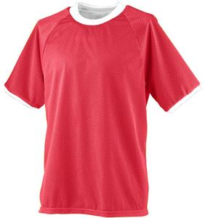
Youth Athletic Reversible Jersey
Loveland Mountain Rentals Inc.
  (401 E. Eisenhower Blvd, Loveland)
Price: approximately $15-20
Mandatory purchase separate from fee if needed
Buy them a little big so children can use for multiple years!
Need help purchasing or wanting to donate gently used equipment/jersey’s to the City of Loveland foundation?
  Contact Savannah Garcia
    Savannah.garcia@cityofloveland.org
    970.962.2445

Slide 15

Team Sideline/loveland
http://www.teamsideline.com/sites/loveland/home
Game schedules
Important announcements
Inclement weather conditions
Park/gym maps
Sports league information/rules
Program info sheet
Coaches list
Picture flyer
Sign up for text alerts
Volunteer coach

Slide 16
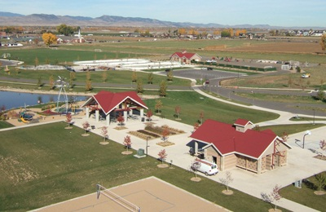
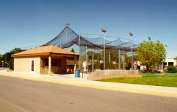
Practice Location
Team practice will be held twice per week (M/W or T/TH)
If a make up practice is needed contact coordinator to make arrangements
Practice Sites
  Basketball practices (various elementary and middle schools)
  Baseball/Tball practices (North Lake Field & Kroh Park)
  Flag Football practices (various parks)
  In-Line Hockey practices (LSP rink)
  Lacrosse practices (Kroh Park)
  Soccer practices (various parks)
  Softball practices (various parks)
  Itty Bitty Ballers (practice will be on same day as games at the Chilson Center)

Slide 17



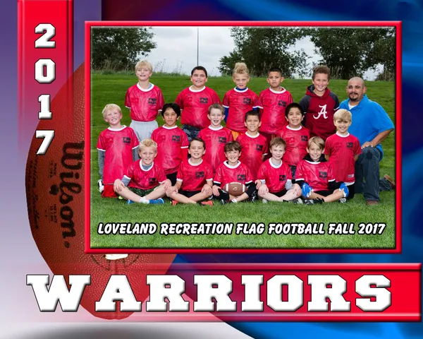
WestWind Photography
Westwind Photography schedules times & dates for team/individual pictures either at practice or on game day.
The picture flyer is located in your coaching packet and can be found online on TeamSideline/Loveland.com
Pictures will be distributed prior to the last week of games
Separate optional purchase
  Complimentary team photo for coach

Slide 18

Volunteer Program
Thank you! The help you provide as volunteers is invaluable, and absolutely crucial to the success of our sports programs!
We hope that you have fun and a rewarding experience while volunteering this season. And look forward to seeing you all in the future.
At the end year Savannah will be sending a survey to all volunteer coaches – please respond so we can get a pulse on how all of you feel! We want our volunteer program the best it can be!
Volunteer’s Reward!
  Coaching Clipboard (please don’t forget to take with you)
  Child’s fee waived for the season
  The opportunity to change a child’s life!
New this coming year!
  Looking to start a recognition program for seasons of service
    Please write down your name, number of seasons or years (please specify season or year), sport/sports you have coached.

Slide 19
HAVE FUN! IT’s recreation
https://www.youtube.com/watch?v=VnpIzESboJ4

Slide 20
Thanks!
Contact sport administration if you have any questions, comments or concerns

