Slide 1

Information for Coaches

Slide 2
Contact Information
Questions?
Please first check our website; there is a lot of information including an FAQ, downloads section with helpful documents, and links to other soccer sites.
https://teamsideline.com/sites/jpcsregister/home
If you cannot find your answer online, Email us:
Registration/general issues or to volunteer to help run the league: contact@jpchildrensoccer.org
Coach Coordinator:
coaches@jpchildrensoccer.org
Equipment issues?
jpcsequipment@gmail.com

Slide 3
About JP Children’s Soccer
Completely volunteer, parent-run organization
Ages 3.5 to 6.5
Practice and games at Pinebanks Field adjacent to Jamaica Pond
Spring and Fall seasons
Each soccer season lasts for 8 weeks
No Saturday practice on holiday weekends (Memorial Day in Spring, Columbus Day in Fall)
One practice/week: Weds, Sat, or Sun
JPCS is always looking for new volunteers. Talk with one of us at the coaches meeting if interested.

Slide 4
JPCS Objectives
Ongoing enjoyment of the game
Comfort and confidence with a ball at the feet
Gradual development of ball control with the feet

Slide 5
JPCS Philosophy
JP Children’s Soccer is dedicated to providing children with an experience in which they will have fun, feel good about themselves and, at the same time, learn basic soccer skills.
JP Children’s Soccer introduces kids to the concept of being on a team while learning and playing soccer, and connects the community in a fun outdoor activity.
Children are natural soccer players; therefore, the role of the Coach should be to provide positive reinforcement as well as instruction.

Slide 6
JPCS Philosophy (cont.)
“The most fundamental skill in soccer is individual mastery of the ball and the creativity that comes with it. This should be a priority in training and games, especially in the early years.”
From Best Practices for Coaching Soccer in the United States, United States Soccer Federation

Slide 7

JPCS Philosophy (cont.)
Every child should have their own ball at all times, and no child should have to wait for their turn to play.
If nothing else, our goal is that each child should touch the ball with their feet as many times as possible during JP Children’s Soccer practice.
This is the foundation of all soccer skills.

Slide 8
Coaching: The Basics
Be on time
Do not add kids to your team without checking with the coordinators (liability issues and waiting lists).
Cancellation if
  rain within 15 minutes of practice or game OR if lightning in the area
Kids should be kept up on the flat field and out of the fishbowl.
No drop-offs - a Parent or Guardian must be present at every practice and every game
Involve the parents
  parents can/should participate in drills and activities.
  enthusiastic parents may transition into much-needed volunteer coaches for the next season
Please contact your co-Coaches if you can’t make it to a practice or game
After practice, clear your goals/cones from the field for the next team.

Slide 9
Coaching: Key Principles
Have Fun!
Provide Positive Reinforcement
Be Organized

Slide 10
Have Fun!
And if you’re not having fun, look like you’re having fun. It’s contagious and the kids will feed off of your attitude.
“Life is more fun if you play games.”
-Roald Dahl

Slide 11
Provide Positive Reinforcement
Nothing gets the kids involved and active at practice more than hearing that they’re doing a good job. Offer up lots of words of encouragement and praise to the kids.
“Correction does much, but encouragement does more.”
-Johann Wolfgang von Goethe

Slide 12
Be Organized
A little bit of organization goes a long way. Coordinate with your coaches before and during practices. Keep the activities flowing.
“Organizing is what you do before you do something, so that when you do it, it is not all mixed up.”
-A.A. Milne

Slide 13
Coaching Tips
Avoid Long Lines. Play a variety of practice activities that include everybody in the group.
Keep Things Moving. Drills/Activities are usually good for 4-8 minutes. When the kids start losing focus, move to the next activity.
It is perfectly OK for a child not to participate
  sometimes a child needs to watch for a while and will eventually jump in
  the child will play when they are ready – don’t force it!

Slide 14
Typical Practice Session
Meet and greet in a circle - adhesive name tags or fabric paint names are great!
First practice: come up with a team name & cheer.
Stretching - touch toes, elbow behind head, side stretch, etc
Warm-up - jumping jacks, run on the spot, run to tree and back, run like an animal.
Kids walk (then run) around a defined area and try not to bump into each other (+/- ball, at different speeds)
Follow the coach
Red light/Green light
Cops and robbers
Dribble with ball to a line and stop on the line (sound effects?)
Messy back yard
Gather team for team cheer.
SNACKS!!

Slide 15
Concussion Awareness
The City of Boston requires that coaches in all sports leagues be trained about sports-related concussions and head injuries. JPCS requires that all coaches complete a CDC online training program titled:
Heads Up! Concussions in Youth Sports
https://www.cdc.gov/headsup/youthsports/training/index.html
After you’ve taken the training, please download a copy of your certification (can be saved as a PDF) and send it to coaches@jpchildrensoccer.org

Slide 16
Parents
As mentioned previously, JPCS practices need active parental involvement. Why?
Coaches need help to keep the practice moving, to accommodate the short attention spans of our players.
The kids love it when their parents are involved. Kids love to play with their parents! This can make the difference in getting a shy child to take part. This
doesn't mean that you should babysit your child on the field, but show that that you are also taking part in the fun.
You will love it! It's fun and is another chance to create a bond with your child.
Don't wait for the coaches to ask for help. Volunteer. Approach the coaches at the start of practice and ask what is planned and where do they need parents. Every practice you can encourage all of the children as they dribble, shoot and score. Be cheerleaders, chase stray balls, help keep the kids moving in drills, help focus them back on the task when they become distracted, help retrieve the balls from the nets etc.
Coaches: with this in mind, plan ahead on where you could use parental help and lay that out for parents at the start of practice.
Note that this is not a call for more coaches on the field. The team coaches have a plan and "too many cooks...." But do help the coach in implementing the lesson plan. And if you love this and think you want to give coaching a try, there is plenty of opportunity in 5 short months with the new season.

Slide 17
JPCS Practice Activities Level 1&2
These are some examples.
Check the links on the website for many more!

Slide 18
Simon Says
Every child has a ball
Simon says to touch the ball with your knee, head, elbow, big toe, ear, nose, shoulder
Simon says to touch the ball with your hand
→ remind the children, “NO HANDS”
the more creative you are with your requests, the more fun for the kids

Slide 19
Follow the Coach
Every child has a ball
Coach dribbles ball around field – children follow
Coach calls (and demonstrates)
  only use your right foot
  only use your left foot
  only use the insides of your feet
  only use the outsides of your feet
  only use the soles of your feet
Alternative
  children dribble inside a defined space
  Coach calls the same variations

Slide 20

Red Light, Green Light

Slide 21
Messy Backyard
Players and balls divide onto each side of a “wall” and try to clear all the balls from their side onto the others.

Slide 22
Camp Town Races
Players race dribbing their balls into the net.

Slide 23
Sharks & Minnows
(or Superheroes & Villains)
Coaches are “sharks” in the middle, while the “minnows” dribble their balls across the opposite line before the sharks try to kick the ball away from them. The minnows then become sharks when they lose their ball. Note younger children may have trouble with this or may prefer to be the ‘shark’ with the coaches the minnows (though the roles are the same), or try renaming entirely to superheroes & villains.

Slide 24
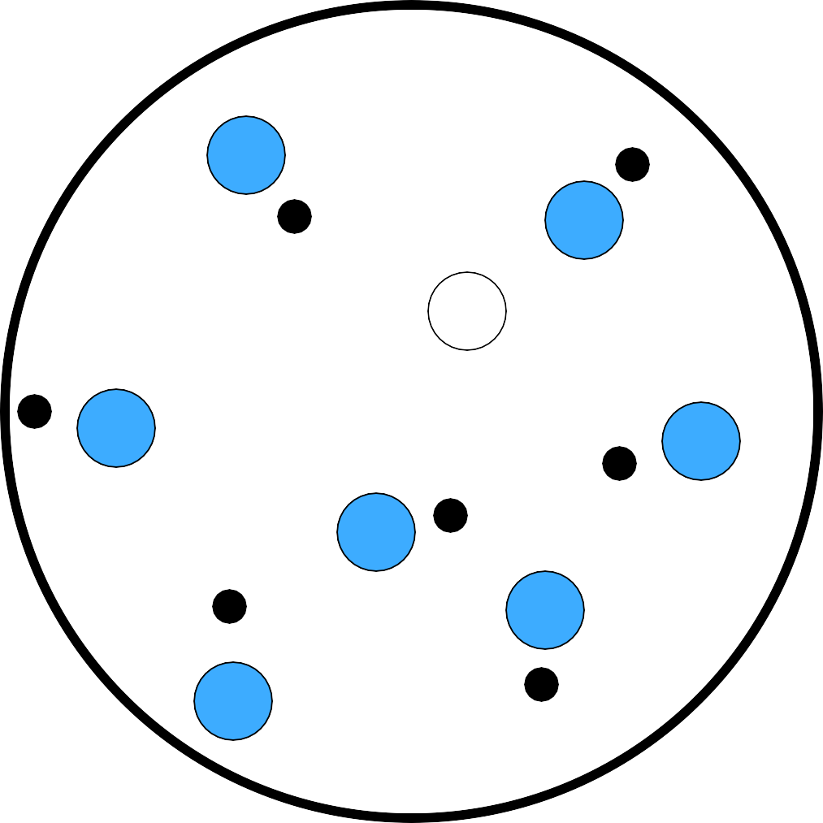
Pirate
One player is the pirate and attempts to steal the ball from the other players. Once a player loses their ball, they also become pirates.

Slide 25

Egg Hunt
Players collect stray balls into the net.

Slide 26

Marbles
Players line up and try to hit a target in the middle by kicking their ball.

Slide 27
Cone Soccer
Players try to knock over cones with their balls.

Slide 28
Dribble, Shoot and Score
Note: make the cross traffic heavy to simulate game atmosphere. Tell kids to keep head up to prevent crashing.

Slide 29
Knock down the Wall
Set up cones between two teams. Players kick balls to knock cones into other teams’ area. Players can only retrieve balls on their side. Team that knocks the most cones wins.

Slide 30
JPCS Practice Activities Level 3
The following games may be more appropriate for Level 3 players, but can be applied in modified forms at all levels.

Slide 31
The Gauntlet
Child dribbles through each zone and defenders must stay within their zones, designated by cones.

Slide 32
Knock down the wall
Set up cones between two teams. Players kick balls to knock cones into other teams’ area. Players can only retrieve balls on their side. Team that knocks the most cones wins.

Slide 33
Pirates on the River
Children dribble balls across “river” past pirate defenders and attempt to get to other river bank.

Slide 34
Through the Wall
First team must complete two passes to each other, then pass it through defenders to second team. Second team then repeats.

Slide 35
Pass and Race
A passes ahead to B, runs to space vacated by B and then races B (who is dribbling ball) to end line. Repeat in reversed roles.

Slide 36
2 vs 1
A passes ahead to B and runs to space vacated by B. B and A then try to score on defender until score is made or defender kicks it out. Transition to A becoming B, B becoming defender and defender becoming A.

Slide 37
Cross pass and score
Player A dribbles along side line up to second cone, where he makes a cross pass. Player B at the same time runs up then crosses the net to meet the pass and shoot on net. With skill level, increase difficulty by adding a defender, then another striker.

Slide 38
Scoring on Defender
Child has to dribble ball past defender(s) who are planning a zone roughly in front of net. Increase number of defenders with skill level.

Slide 39
Equipment
If you have any equipment issues mid-season, eg broken nets, not enough t-shirts, need extra balls or cones, please Email:
jpcsequipment@gmail.com
If soccer balls are deflated, we can also help if you are unable to pump them up at home.

Slide 40
End Of Season
Please return equipment (balls, nets, cones, and pinnies for Level 3 PROMPTLY.
Please return any UNUSED t-shirts as we will use them for future seasons.

Slide 41
THANK YOU FOR VOLUNTEERING!!!
This is a parent-run league and we are immensely grateful to all who help out.

