Slide 1

2025 Winter Basketball Coaches Meeting
YMCA Moody Sports

Slide 2

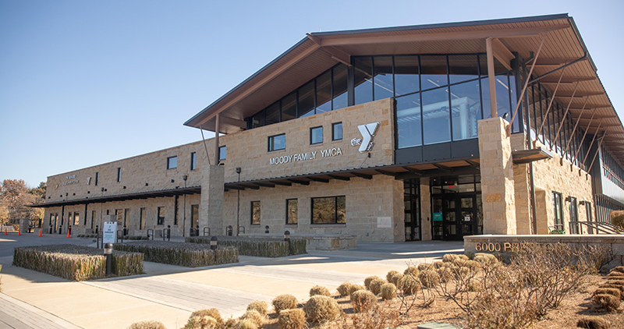
Introductions
Moody Sports Team
Ty Langston – (K-2)
Jessica Torres "JT" – (3-6)
Jake Lamb– Regional Director

Slide 3
Coach Compliance
Volunteer Matters
Athlete Protection
CBC
These are required
EVERY YEAR
Returning coaches: Please make sure you add your name to the sport need & check that credentials are up to date. New coaches: follow the guide & email May for any questions or help.
These need to be done ASAP!
https://ymcadallas.volunteermatters.org/project-catalog/307
Contact May for any questions!
mmacgregor@YMCADALLAS.org

Slide 4
Jerseys/Equipment (Steven from NJS)
6921 Preston Rd
214-528-5006
No personal names
Y logo should be present!

Slide 5
Photos (Autumn LEaves Photography)
Once we receive the game schedule from the Y, we create a picture day schedule, typically set at your game locations for convenience. We’ll email you a SignUpGenius link to sign up for a photo slot for your team, or you can always find picture days scheduled here https://www.autumnleavesphotography.com/Team-Picture-Signup
Scheduling: Reserve your team’s slot using the SignUpGenius link in your email. If your game changes, adjust online or email me at info@autumnleavesphotography.com—I’ve got you covered!
Photo Day: Bring your team to the location you signed up for, arriving 10 minutes before your appointment time. We’ll start with individual pictures, followed by team shots—wrapping up in about 15-20 minutes. Parents can fill out a pre-order form on-site if they’d like to purchase photos for their kids.
Coach Perk: The head coach and assistant head coach each receive a complimentary 5x7 Coach/Child picture with a pre-order purchase. Be sure to pose with your child during the session to claim it!
Team Bonus: If every player’s family pre-orders, Autumn Leaves Photography provides a free team digital photo as a thank-you.
Secure your slot soon—times fill up quickly! For questions, text or call me at 469-759-0766 or email info@autumnleavesphotography.com. I’m excited to capture your team’s story this season!
Ron & Family will also reach out individually when he has schedules!

Slide 6
General Information
REGISTRAION IS CLOSED.
Games Start December 3rd
First Practice Weeks will be Dec. 1st
Games schedules estimated by Monday (or sooner)
Games Slots
Wednesdays (6:15pm-9:15pm) : 5/6 Boys
Fridays (5pm-8pm) : 5th Girls
Saturdays (8am-4pm) : Everyone Else

Slide 7
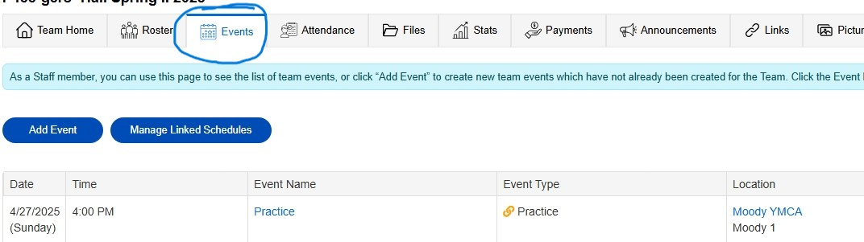
Practice requests
Practices
If you want practice space on our courts, please fill out the practice field request form. (Sent out via email tomorrow starting at 10AM) Younger grades get fist pick. Fill out by Fri at 5pm.
*Space is limited.
Practices for 1st-6th will be held during the week (M-F). Kinder division does not need to reserve practice space. 15 minutes of practice at start of game time.
These Practices Start Dec. 1

Slide 8
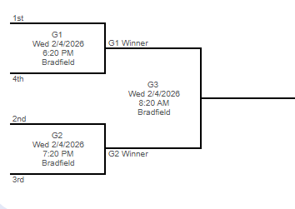
Game Schedules
4th – 6th
Playoffs at the end of the season.
4 top teams will play. Ranking by wins.
Please remind your volunteer score keepers to write in team & coaches name + scores.
Will be posted by Monday 11/24. Games will start Dec 3rd. Nothing during Thanksgiving. Get your conflicts into us via email: tlangston@ymcadallas.org or jessica.torres@ymcadallas.org.
(Ex. My team will not be able to field a full squad on Saturday, 1/10 due to half of our team going out of town)
Approved cancelations are for snow/Ice, courts or facility issues, & any Y scheduled events. (not for your friend's birthday party or individual school event) *We will not reschedule.

Slide 9
Gym Locations
Kinder: Armstrong
First Grade: Hyer
Second Grade: UP, Moody, MIS
Third Grade: Boone, Bradfield, MIS
Fourth Grade: MIS
5th Grade: Bradfield, Hyer, Moody
6th Grade: Bradfield, Hyer

Slide 10
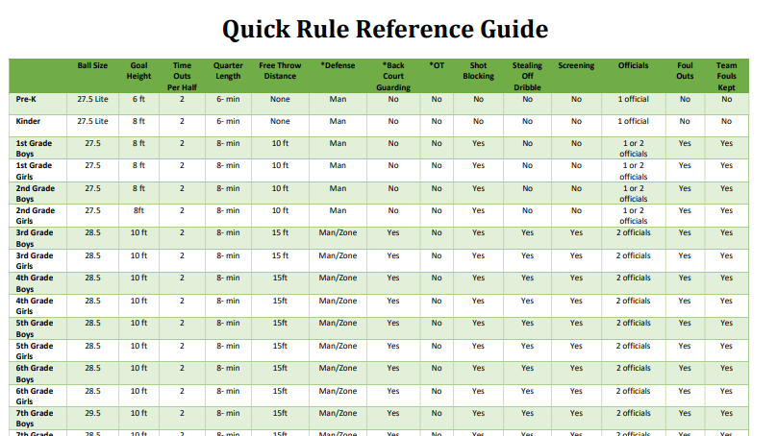
Rules

Slide 11
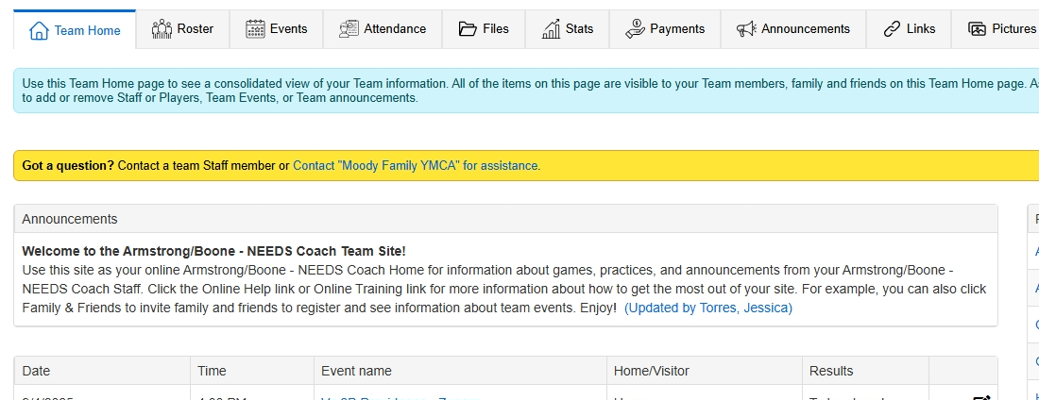
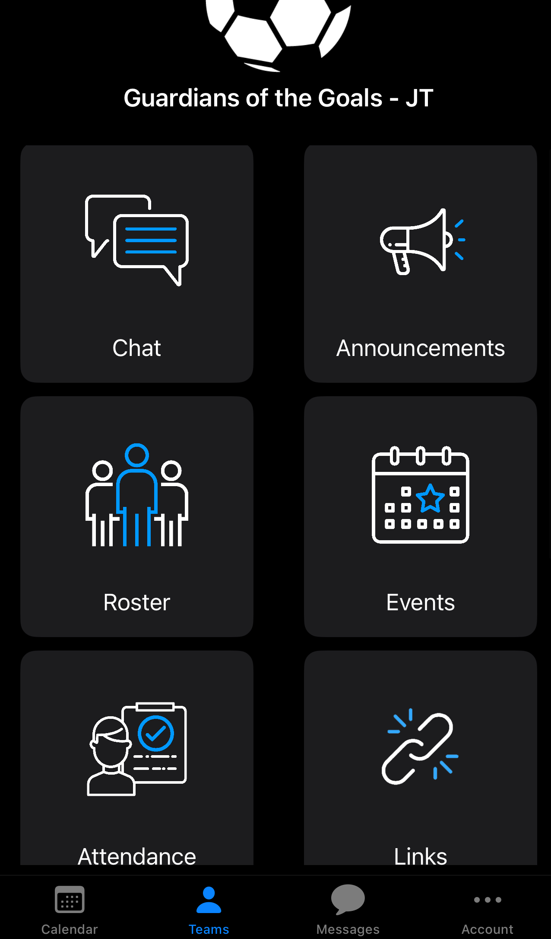
Team Sidelines
Teamsidelines is where you can find:
Schedules
Rosters
Rules
Team Sites
Please make sure you have opted in to receive messages, as we utilize this site often.
Coaches will get most messages- please share with your team!

Slide 12
Coaching Reminders
Create a group chat or email chain with your parents if you have not already done so
Come up with sub rotations so every kid plays equally
Be respectful of officials and school facilities (Have your parents help pick up trash)
Help us control your team representatives

Slide 13
Listen 360 surveys
Surveys are sent out randomly the last two weeks of the season.
Please help us learn about what we are doing well or how we can improve.
All surveys are read and responded to by myself or Ty.
Moody NPS score is a part of employee reviews.

Slide 14
Questions?
K-2nd– Ty (tlangston@ymcadallas.org)
3rd-6th– JT (jessica.torres@ymcadallas.org)
Facility/Program Wide Concerns – Ty Langston (tlangston@ymcadallas.org)

