Slide 1
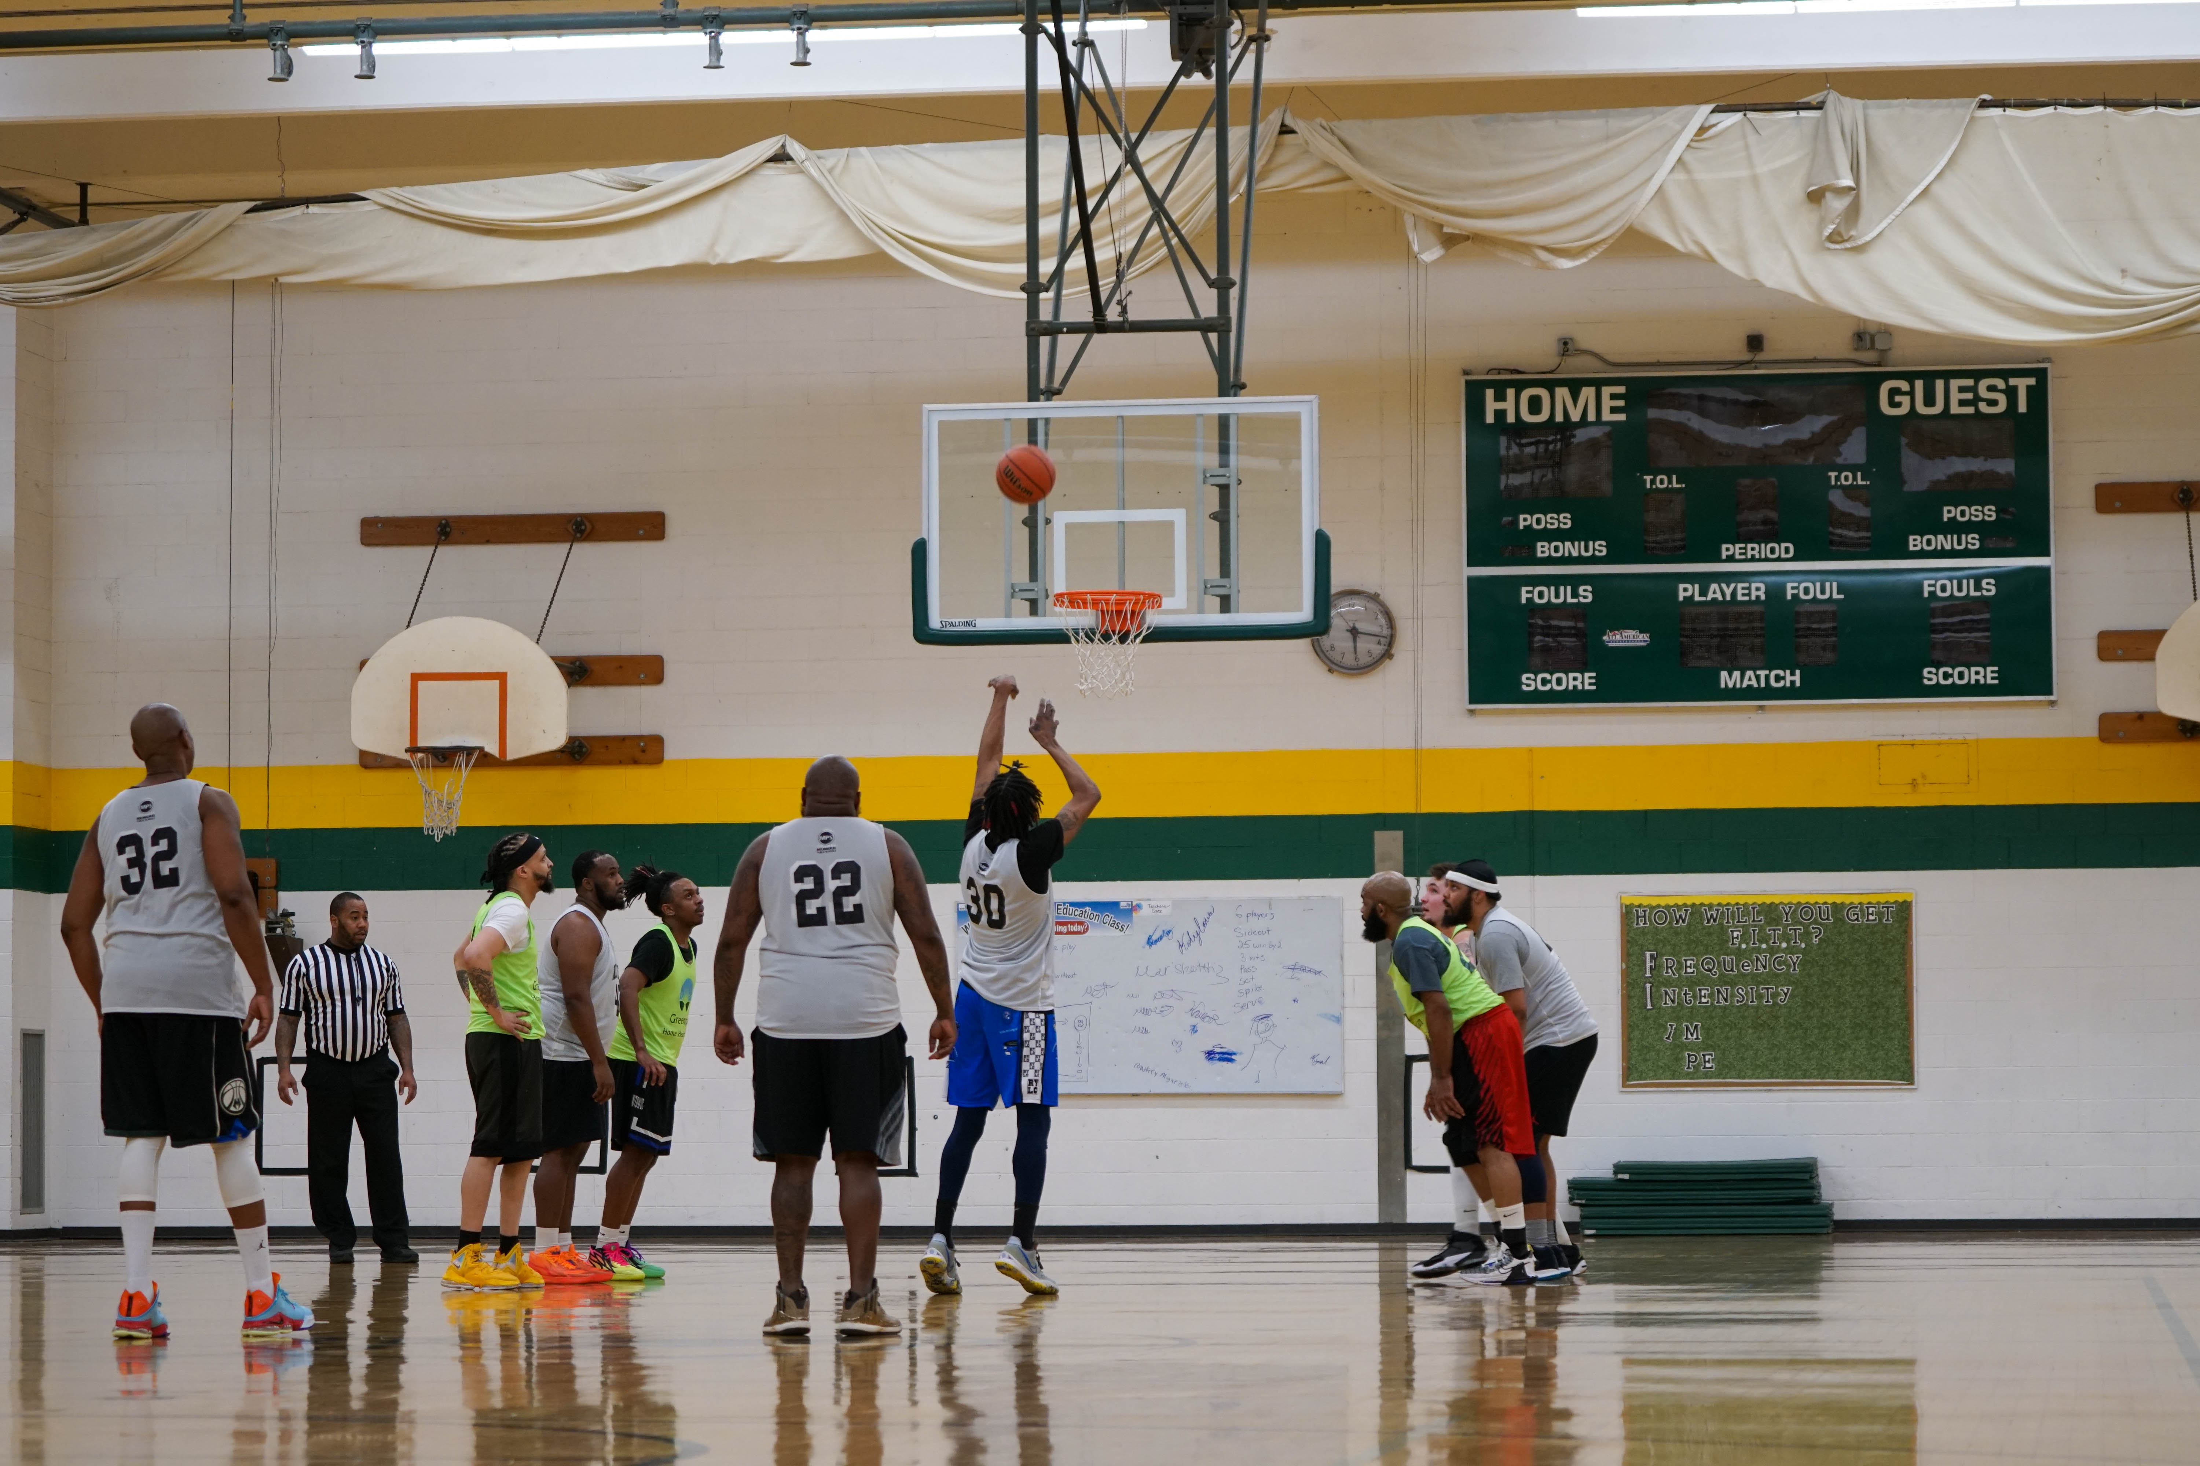

2025-26 Winter Adult Basketball Managers Meeting

Slide 2
IMPORTANT CONTACTS
Adult Sports Office
2414 W. Mitchell St.
Milwaukee, WI 53204
414-647-6046
Hours: 8:30am-4:30pm
Weather Hotline: 414-475-8192
Night Crew (Calls after 5:00 PM)
414-852-3163
Matthew Ryan, Supervisor
matthew@mkerec.net
Office: 414-647-6070
Katie Seitz, Manager
katie@mkerec.net
Office: 414-647-3821
Damaris Aviles, Clerical Team
Office: 414-647-6041

Slide 3
IMPORTANT DATES
Men’s League Start (10 game season): Week of December 1, 2025
Skip Dates: Dec. 22 - Jan. 1, Jan 19, Feb. 17 (Voting)
Men’s All-City Basketball Tournament:
  Tentatively begins week of March 2 (League-wide, single-elimination tournament with game times city-wide between 7-10 PM)
  League winners will receive top 3 seeds
  Any team can enter by paying $25 tournament fee
  Seeding based on strength of league, record, head-to-head competition
  Teams must declare (and pay) by Friday, February 6, 2025

Slide 4
ADULT BASKETBALL LEAGUE GYM LOCATIONS
Alexander Hamilton HS
6215 W. Warnimont Ave.
Bay View HS
2751 S. Lenox St.
Garland Elementary School
3120 W. Green Ave.
*Location Winter 2025-26*
Ronald Reagan HS
4965 S. 20th St.
Milwaukee Marshall HS
4141 N. 64th St.
Wisconsin Conservatory of Lifelong Learning (WCLL)
1017 N. 12th St.

Slide 5
PLAYER STATS
Stats:
  Player Points
  Games Played
  Technical Fouls
League MVP’s will be awarded trophy’s at the end of the season (highest scoring player in each league). League winners will receive t-shirts.
Stats Leaders can be viewed here:
  https://www.teamsideline.com/sites/MilwaukeeRecreation/schedules
  Clicking on your league
  Clicking on ‘See Stats’ in the upper right corner

Slide 6
ROSTER MANAGEMENT
Team Rosters Due: Team Sideline Roster Management
https://www.teamsideline.com/sites/MilwaukeeRecreation/home
Rosters must be submitted by your first game. You can add players up until the completion of Week 3. Rosters will LOCK after week 3 gameplay. NO EXCEPTIONS!
Players must sign the virtual waiver invite on Team Sideline to play
  Week one grace period only otherwise players will not be eligible **FAILURE TO ENROLL ON TEAM SIDELINE MAY RESULT IN GAME FORFEITURES WITH A MAX PENALTY OF REMOVAL FROM LEAGUE**

Slide 7
ROSTER MANAGEMENT Continued
A player may register to play on more than one team in the Milwaukee Recreation Muni Basketball Program provided they are on separate days.
Players must declare which team they intend to play on for the city tournament by the February 6th team deadline.
Sign in Sheet/ID: All players must print their name on the sign in sheet before entering the game in order to be considered a legal player.
All players must be prepared to present an ID in the event of an eligibility challenge.
Failure to sign-in may result in further penalty when determining tournament eligibility.

Slide 8
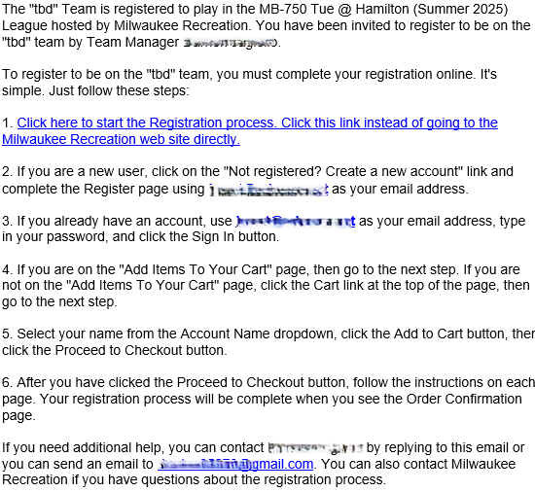

Left Image – where the email will come from and the subject line
Right image – the content of the email and the link (Step one) to fill out the waiver

Slide 9
FREE AGENTS
One player actively looking for a team (any day)
steve luster sluster20@yahoo.com
We have lists of free agents form previous years that are available upon request

Slide 10
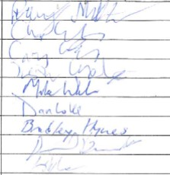
SIGN-IN SHEET
SIGN-IN SHEET ACCURACY AND LEGIBILITY IS CRUCIAL TO THIS PROCESS

Slide 11

RULES OF EMPHASIS
GAME BALL - Each team must furnish an official basketball (leather) in good condition and deemed playable by the officials.
TIE-BREAKER PROCEDURES
The following system will be used to determine league winners and tournament seeding:
  1) Head-to-Head Competition
  2) Head-to-Head Differential
  3) The team with the greatest total point differential against common opponents. In most cases, this will include all games, however, there may be situations that occur where a team did not play every team due to forfeit, weather, etc.
If any of the matchups resulted in a forfeit, the forfeiting team will automatically lose the tie breaker.

Slide 12
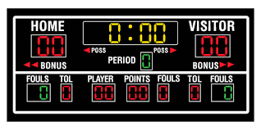
RULES OF EMPHASIS
Game Clock
  All halves of regulation play shall be 18-minute running clock.
  The clock will stop ONLY for time outs, except during the last 2 minutes of each half when the clock will operate in accordance with the National Federation High School (NFHS) Rules – Example: After a timeout, the clock will start when the ball is touched by a player inbounds.
  Mercy Rule: If a team is ahead by 20 points or more at any point after the start of the second half, the clock will run continuously, except during officials and team time-outs. If at any time the point difference falls below 20 points under 2 minutes in the 2nd half, the clock will stop normally.
  Timeouts: Each team has 3 full length timeouts per game.
    Any unused timeouts will carry over into an overtime period and one additional timeout will be granted.

Slide 13
RULES OF EMPHASIS
Grace Period: The officials will allow a ten (10) minute grace period before forfeiting a game due to lack of players. As soon as four (4) players are present, the game must begin at the scheduled time. The grace period is charged against playing time.
Overtime Format (Regular Season + Postseason)
  Elam Ending: A target score is set at the end of regulation by adding 6 points to the tie score. EX) If the game is 60-60 heading into overtime, the target score will be set to 66 (first team to score 6 points).
  The game clock will be eliminated and teams will play until one team reaches the target score. All team/player fouls and timeouts remaining + 1 additional in overtime carry over into this untimed Overtime.
  ELAM Ending: https://thetournament.com/elam-ending/

Slide 14

RULES OF EMPHASIS
Technical & Personal Fouls
  Dunking and/or stuffing the ball is considered a flagrant unsportsmanlike technical foul, which results in 2 free throws and the ball out of bounds to the offended team. The player who committed the dunk/stuff is ejected out of the game and subject to a one (1) game suspension.
  Dunking or stuffing at anytime during warmups, gameplay, or after gameplay will result in an ejection + suspension.
  All Technical and personal fouls assessed to an individual will count toward that player's 5 fouls for disqualification and/or toward a team's 7 fouls for bonus purposes.
  Two technical fouls or ejection will result in a minimum 1 game suspension. Each case will be looked at by the Milwaukee Recreation staff. A second ejection during the season will result in a full season suspension (including dunking).

Slide 15
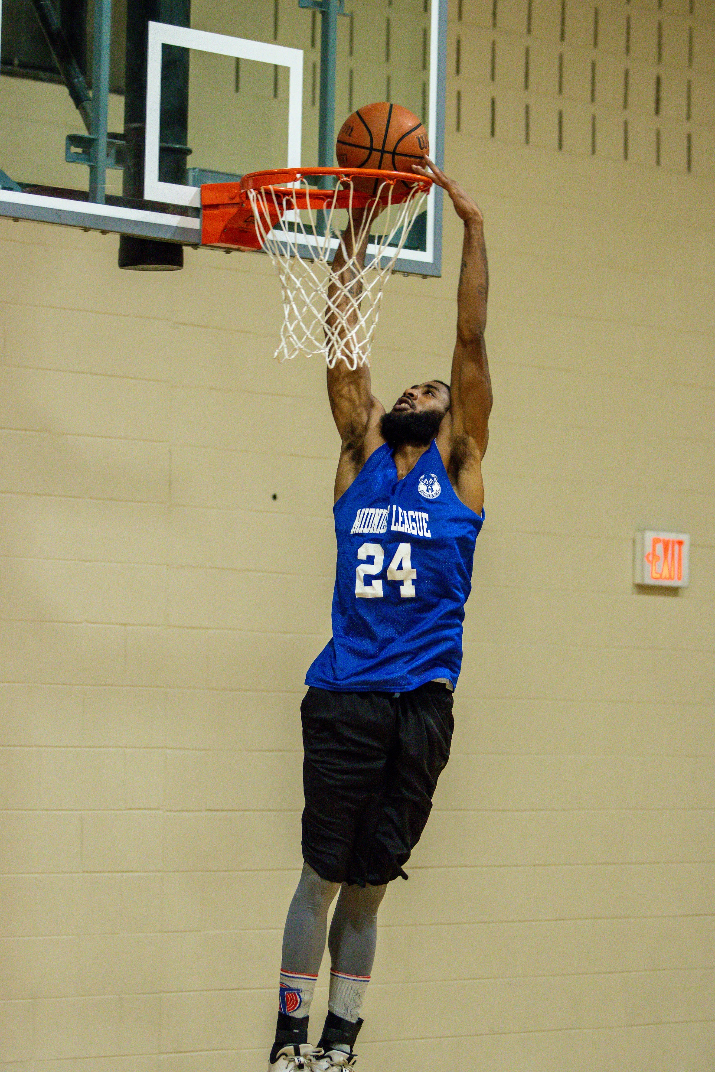
RULES OF EMPHASIS
Example of “Stuffing”

Slide 16
RULES OF EMPHASIS
Only 1 coach (listed on roster) and players are to be in the bench area. All other spectators must sit in assigned spectator zones.
A team member, coach, team attendant, or team follower who is assessed 2 technical fouls for unsportsmanlike conduct is automatically ejected from the game and gym.
The player must leave the gym immediately upon ejection. If the ejected player does not leave the gym in a reasonable amount of time, further action, as deemed appropriate by the referee may result, and could result in forfeiture of the game.
Any technical fouls assessed against a disqualified player shall also be charged to the offender(s), but NOT to the coach or manager unless they are also guilty of the infraction committed.

Slide 17
TEAM UNIFORMS
Legal Uniform Numbers
  Number Placement: Each uniform must have a number. Placement may be printed on the front or back of the uniform HOWEVER, all uniforms must be identical as to the placement of the numbers.
  The numbers must be PERMANENT (silk-screen, iron-on method, sewn on or some other permanent method). Tape is not acceptable. Numbers attached with tape, composed of tape, hand drawn with magic marker or other material will be considered illegal numbers.
  Anyone unable to meet legal uniform requirements MUST wear the provided pinnies. NO EXCEPTIONS.
  We will provide pinnies if teams do not come prepared with uniforms, but do not rely on this for an entire season.
  Uniforms must be the same solid color as your teammates.

Slide 18
OFFICIALS & PLAYERS/GAME MANAGEMENT
3-person officials crews will be assigned to each game
Officials have been instructed on game management.
Players & Managers need to conduct themselves in a respectful manner.
We should not have fighting or threats of violence that spew out into the parking lot.
Compete and play hard, but there are lines that should not be crossed. Firm discipline will be handed out if needed.

Slide 19
Attachment 7: Player Code of Conduct & Sport Rule Adaptations
It shall be the responsibility of the manager to control the behavior of their players on the bench and on and off the field/park. Managers and players are responsible for their conduct from the time they reach the park until the time they leave.
No person shall interfere with or in a manner hinder, threaten, harass, intimidate any participant or employee of Milwaukee Recreation.
Derogatory remarks, profanity, obscene gestures, threats, etc. - directed toward any game official, Milwaukee Recreation employee, MPS staff, other players or spectators will not be tolerated. These infractions may lead to discipline up to and including removal from participation in Milwaukee Recreation programs.

Slide 20
Attachment 7: Player Code of Conduct & Sport Rule Adaptations
Fighting is defined as any attempt by a player or non-player to strike or engage anyone in a combative manner unrelated to the sport. Such acts include, but are not limited to, attempts to strike an opponent(s) with arm(s), hand(s), leg(s), or foot (feet), whether there is contact or not. Any player involved in a physical confrontation (fighting) will be ejected immediately and is subject to further disciplinary action.
Deliberate throwing of equipment or items in anger or disgust will not be tolerated. This will result in immediate ejection from the game without warning and may lead to discipline up to and including removal from participation with Milwaukee Recreation programs.
Arguing on the judgment of an official will result in a team warning. A repeat offense will result in the ejection of that player, manager or coach. The official’s decision involving judgment calls is final.

Slide 21
Attachment 7: Player Code of Conduct & Sport Rule Adaptations
The manager is the only person to confer with an official on a disputed play. Such conferences must be kept to a minimum and will be conducted in a sportsmanlike manner.
Constant arguing, harassment, or intimidation will not be tolerated and could mean ejection from the game and may lead to discipline up to and including removal from participation within Milwaukee Recreation programs.
When a player, manager or coach is ejected, the following procedures will be followed:
  The ejected player must produce a valid photo identification. The manager is required to comply with the official’s request. Lack of cooperation from any manager or team in regard to such ejection may lead to discipline up to and including removal from participation with Milwaukee Recreation programs.
  Ejected players are to leave the field/court of play immediately. This includes the player bench and the area around the bench. If necessary to control the game, officials have the authority to eject offenders from the park/gym. When ejected from the park/gym, they are to leave immediately. It is the manager’s responsibility to see that the individual abides by such rules. If the manager is ejected, a team representative may fill in.

Slide 22
Attachment 7: Player Code of Conduct & Sport Rule Adaptations
Continued:
  If a player is ejected and continues to harass the official, the manager will be warned to control their player’s action. If the manager does not comply, the game will be forfeited. In any serious unsportsmanlike conduct incident such as teams fighting or complete loss of control of players by a manager, the official shall have the authority to forfeit the game without a warning.
  Ejected players subject to discipline are notified of such action by the Adult Sports Office. The player disciplined has the right to a hearing if a suspension extends beyond three (3) games. Request for a hearing must be made to the Adult Sports Office within three (3) days of notification of such discipline if applicable.

Slide 23
CONTROLLED SUBSTANCE POLICY
ZERO TOLERANCE POLICY!
  No individual is allowed to participate in or be in attendance as a spectator while using, under the influence of, or possessing a controlled substance. Violation will result in the individual(s) being asked to leave the facility, as well as face possible suspension from Milwaukee Recreation programs and possible referral to the City of Milwaukee Police Department.
City of Milwaukee charter & code of ordinances
  Chapter 105-50; Public Safety, Use of Marijuana
  Chapter 9039; Liquor and Tavern Regulations
In summary, the use or possession of controlled substances is prohibited on MPS property, including all facilities used for Milwaukee Recreation Programs.

Slide 24

BUILDING ENTRANCE - SCANNING
All spectators and participants are subject to scan & search upon entry.
Milwaukee Recreation reserves the right to remove anyone in violation of event rules and regulations.

Slide 25
POINTS OF EMPHASIS
Inclement Weather Procedure:
  In the event of inclement weather/school closure, the Weather Hotline and Facebook will be updated with any known cancellations by 4pm.
  Both the Weather Hotline and Facebook will continue to be updated as field are cancelled, even after games start.
  MPS Policy: If the district is closed, all recreation activities will be cancelled.
Rescheduled Games:
  All games will be rescheduled. All games that are rescheduled will be posted on the Milwaukee Recreation scheduling website and an email will go out to all enrolled managers/players through Team Sideline.
  WEATHER HOTLINE: 414-475-8192

Slide 26
POINTS OF EMPHASIS
Forfeit Procedure:
  If a team does not notify the Adult Sports Office of a forfeit by 12:00pm on the day of a game, they will be subject to a $25 forfeit fee. This fee must be paid before the team’s next scheduled game or the team will continue to forfeit games.
  If you need to forfeit and it is after 5:00 PM: Call 414-852-3163

Slide 27

WEBSITE
https://www.teamsideline.com/sites/MilwaukeeRecreation/home
Schedules
Standings
Player Stats
Game Scores
Rules & Regulations
Contact Information
Like/Follow us on Facebook:
Adult Sports-Milwaukee Recreation

Slide 28
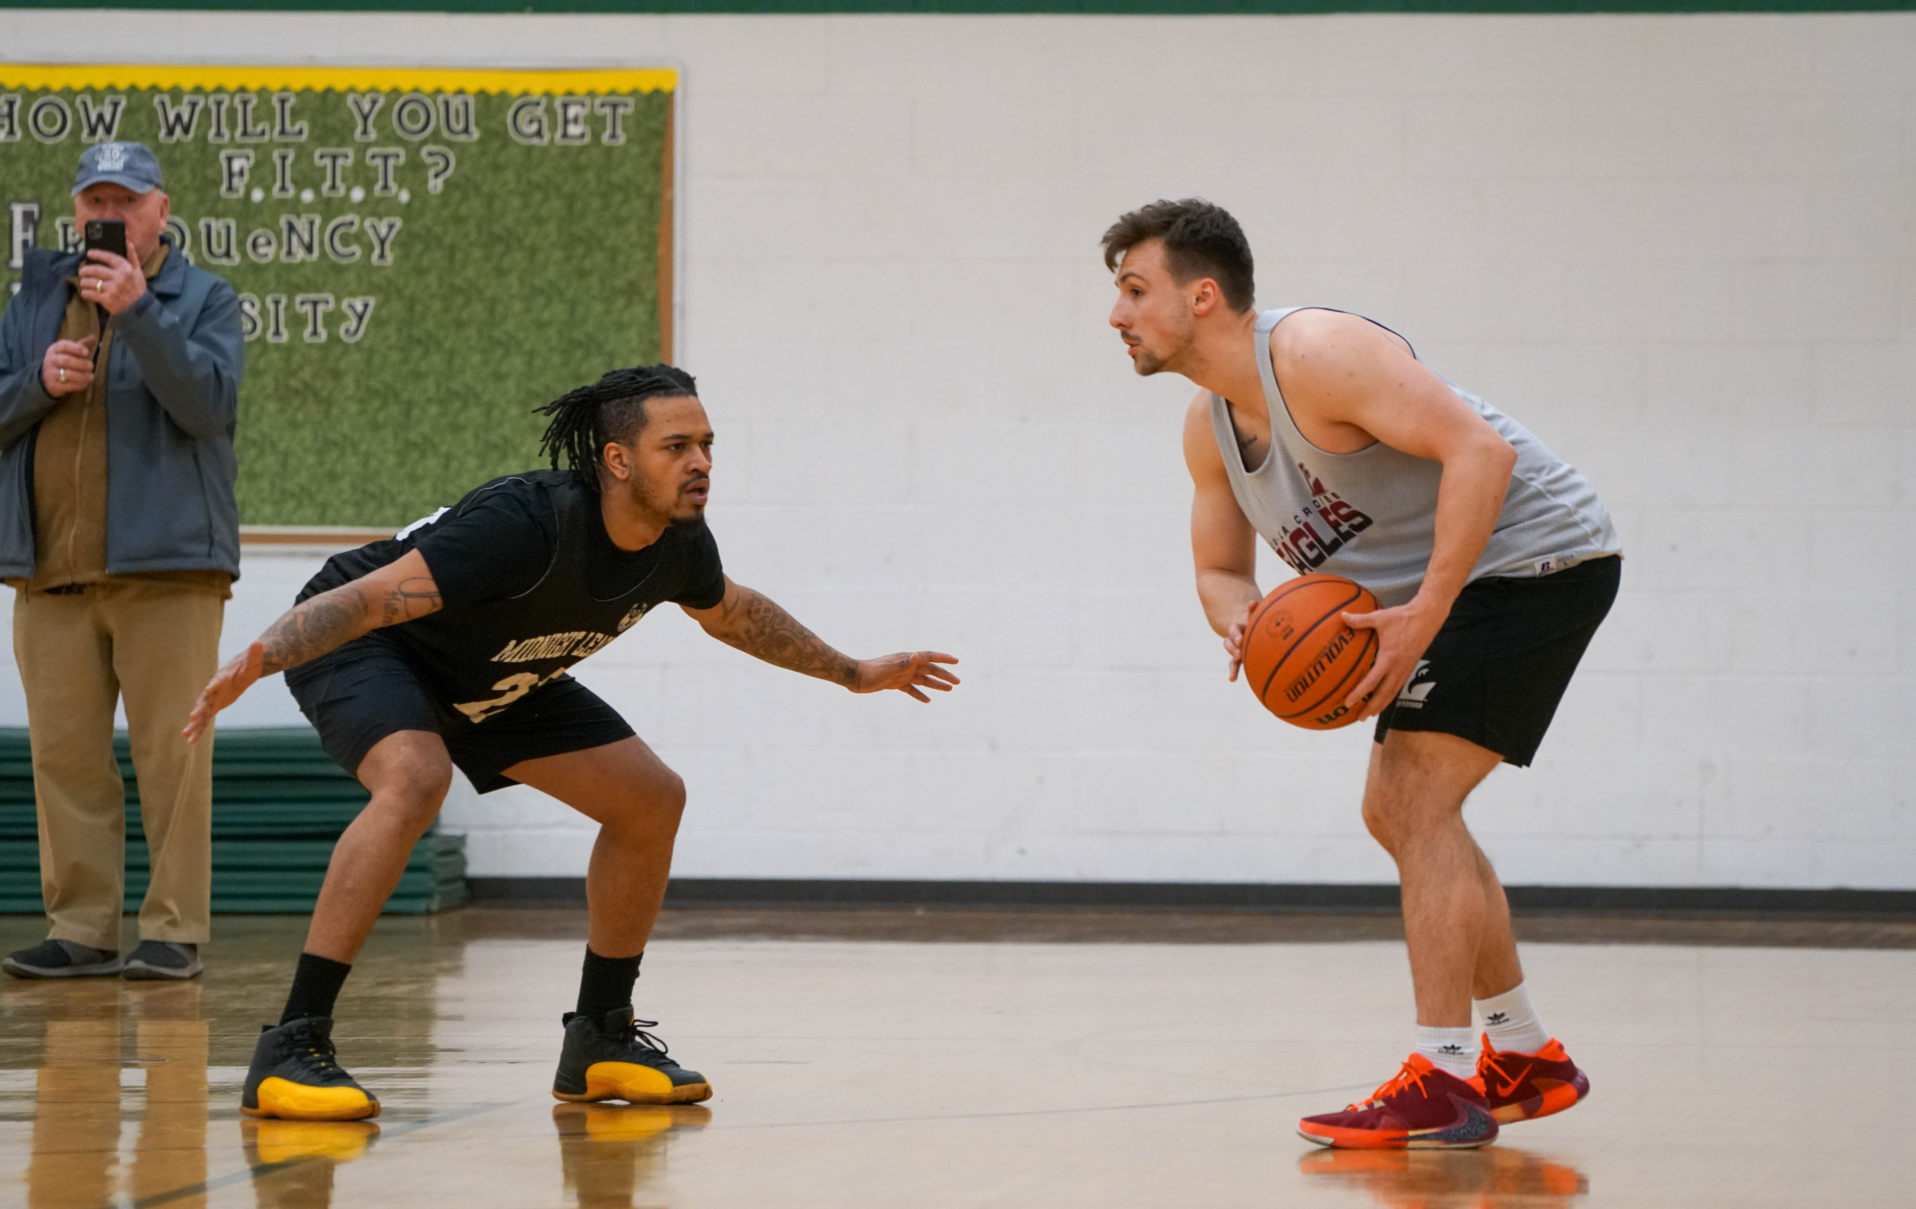
QUESTIONS?????

