Slide 1

North Natomas Little League Baseball/Softball/Challenger
Annual General Meeting
August 19, 2024

Slide 2
2023-24 NNLL Board members
Lydia Ramirez - President president@nnll.org
BOD Committee - Vice President Baseball baseballvp@nnll.org
David Lindner - Vice President BB Minors minorsvp@nnll.org
Jeff Pawelczyk - Vice President Softball softballvp@nnll.org
Kim Keys-Rosenfeld - Vice President SB Minors sbminorsvp@nnll.org
Mike Mattsey - Vice President Tee Ball teeballvp@nnll.org
Adam Reinertson - Coaching Coordinator coaching@nnll.org
Angela Fisher - League Administrator leagueadministrator@nnll.org
BOD Committee - Baseball Player Agent baseballagent@nnll.org
Lisa Myers - Softball Player Agent softballagent@nnll.org
BOD Committee - BBB Minors Player Agent baseballagent@nnll.org
Melissa Dhanis - Safety Officer safety@nnll.org
BOD Committee - Snack Bar Coordinator snackbar@nnll.org
Bill Yoder - Equipment Coordinator equipment@nnll.org
Kayla Crain - Scorekeeper in Chief scorekeeper@nnll.org
Karla Fuhrman – Secretary/Information Officer nnll@nnll.org
Laura Zuniga - Treasurer treasurer@nnll.org
BOD Committee - Sponsorship Coordinator sponsorship@nnll.org
Anita Laxton - Team Parent Coordinator teamparentcoordinator@nnll.org
Laura Ackland - Events events@nnll.org
Emilio Haro - Umpire in Chief umpires@nnll.org
Joe Crain - Fields
fields@nnll.org
Billy Dhanis - Fields fieldsprep@nnll.org
Clinton Williams - Fields Coordinator fieldscoordinator@nnll.org
Kim Keys-Rosenfeld – Social Media social@nnll.org

Slide 3
Agenda
Welcome
State of the League:
  Registration numbers: Fall of 2023, Spring of 2024, Summer of 2024
  Statement of Accounts – Financials Reviewed
  Hit–A–Thon/Dine In Fundraisers – Projects
Summer TOC/All-Star Successes
Proposed Candidates for the 2024/2025 Board of Directors Slate
Voting Results:
  Results of Renaming/Eliminating/Combining Board Positions
                Rename Secretary/Information Officer to Secretary/Communications Coordinator; Eliminate Social Media
                Combine Team Parent/Snack Bar Coordinator and make it a “Co” role
  Results of the 2024/2025 Board of Directors Slate
Meeting Adjourned into Closed Session

Slide 4
State of the league
Registration numbers: Fall of 2023, Spring of 2024, Summer of 2024:
Fall Ball 2023 Spring 2024 Summer 2024 Enrollments by Divisions
BB Juniors – 51 | BB Seniors - 18 | BB Seniors – 16
BB 50/70 – 29 | BB Juniors – 34 | BB Juniors – 12
BB Majors – 37 | BB 50/70 – 34 | BB 50/70 – 12
BB Minors – 123 | BB Majors – 57 | BB Majors – 12
BB Rookie – 54 | BB Minors – 250 | BB 11s – 12
BB Teeball – 16 | BB Rookie – 164 | BB 10s – 12
SB Juniors – 12 | BB Tee Ball – 182 | BB 10u – 13
SB 12u – 55 | SB Juniors – 27 | SB 12u – 12
SB 10u – 29 | SB 12u – 54 | SB 10s – 12
SB 8u – 19 | SB 10u - 56 SB 8u – 57 | SB 10u - 14
SB 6u – 10 | SB 6u – 35 | Total - 127
SB Tee Ball – 4 | SB Tee Ball - 34
Challenger – 5 | Challenger – 12
Total - 445 | Total - 959

Slide 5
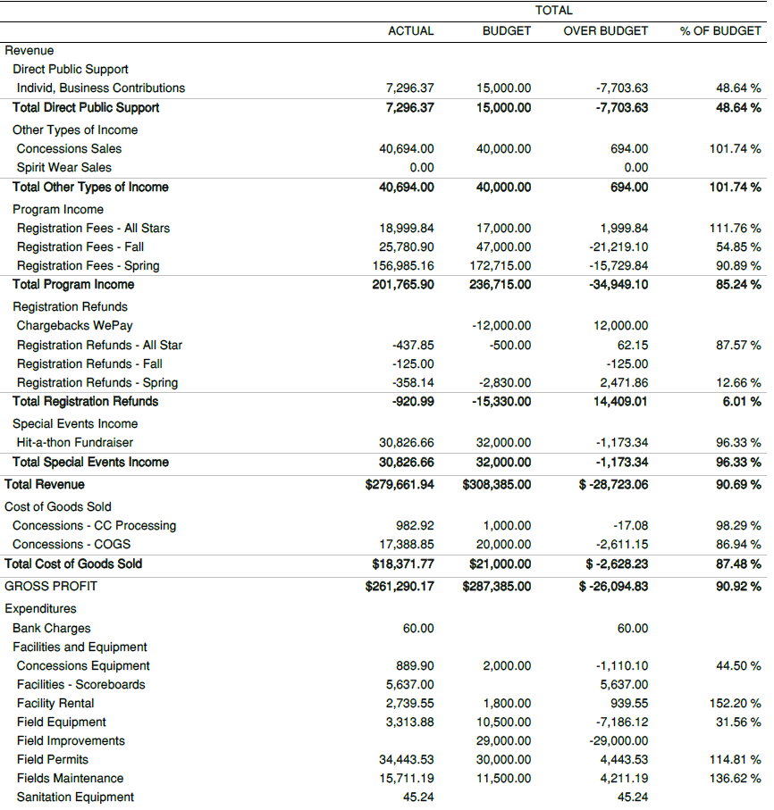
Statement of accounts
Statement of Accounts:
Financials Reviewed
Budget v Actuals
Oct 1, 2023 – Aug 16, 2024

Slide 6
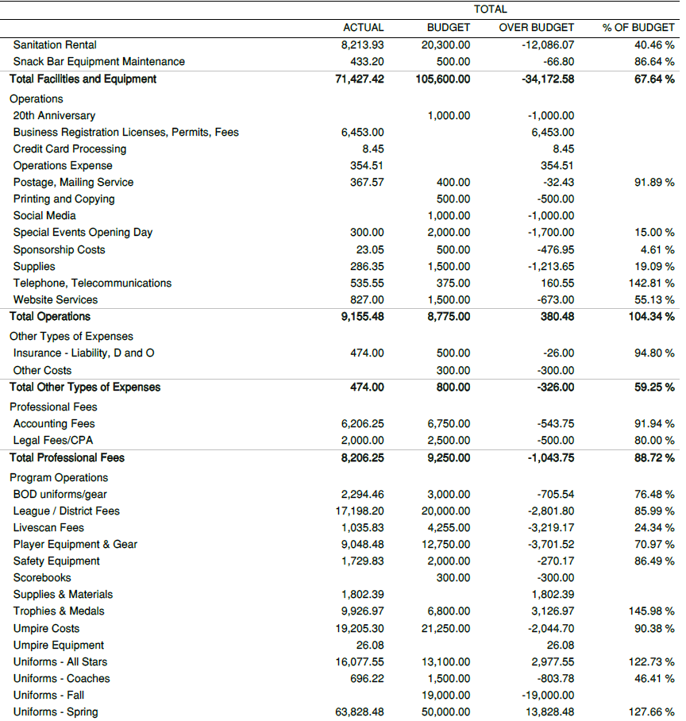
Statement of accounts
Statement of Accounts:
Financials Reviewed
Budget v Actuals
Oct 1, 2023 – Aug 16, 2024

Slide 7
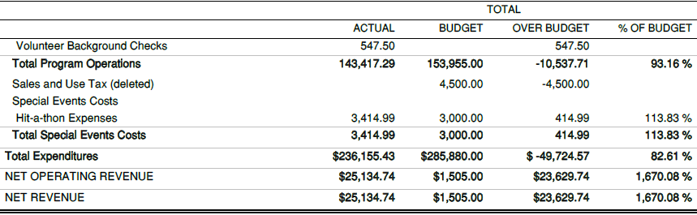
Statement of accounts
Statement of Accounts:
Financials Reviewed
Budget v Actuals
Oct 1, 2023 – Aug 16, 2024

Slide 8
Hit–A–Thon/Dine In Fundraisers
SCOREBOARDS:
Scoreboard on NNRP Field 5 – Installed
Scoreboard on NNRP Field 2 – Installed
Scoreboard on NNRP Field 4 – Installed – working through electrical issues
SNACKBAR:
Need to purchase new ice machine to be moved inside of the Snackbar, out of the breezeway
Purchased new freezer for additional ice cream space
NNRP LIGHTS:
Councilmember Lisa Kaplan let us know of the new project budgeted and approved for by the City of Sacramento in 2025, this will bring lights to Fields 1, 2 and 3.
FIELDS:
Purchase/Fix new equipment for Field Prep use

Slide 9
Summer TOC/All-Star Successes
12 Banners Earned in Total for the Summer
Tournament of Champions:
12u Softball – Georgia Bulldogs - Denson
50/70 Baseball – Washington Huskies - Dhanis
AAA Baseball – LSU Tigers - Martinez
All Stars – District Champions – D6:
12u Softball - Esparza
10u Softball – Guenette
Seniors Baseball - Mattsey
Juniors Baseball - Kaye
50/70 Baseball - Fields
Majors Baseball - Olvera
10s Baseball - Juvet
All Stars – Section Champions – S4:
12u Softball - Esparza
10u Softball - Guenette

Slide 10
Proposed Candidates:
2024/2025 Board of Directors
Amy Bingham
Kenny Britton
Rachel Castagnola
Tina Marie De Teresa
Melissa Dhanis
Angela Fisher
Nydia Godoy
Josh Guerrero
Emilio Haro
Matthew Juvet
Kim Keys-Rosenfeld
Joe Koch
Kristina Koch
David Lindner
Matthew Martinez
Adam Reinertson
Timothy Rodda
Kisha Rose
Bobbie Sumpter
Clinton Williams
Bill Yoder
Laura Zuniga

Slide 11
Vote Results
Results on:
        Renaming/Eliminating/Combing Board Positions
          Rename:
          Secretary/Information Officer to Secretary/Communications Coordinator
          Eliminate:
          Social Media (add responsibility into Sec/Coms Coordinator)
          Combine:
          Team Parent/Snack Bar and create “Co” positions
          Election of 2024/2025 Board of Directors

