Slide 1











2021 Youth Baseball Coaches Meeting
Park Board Leagues

Slide 2
Introductions
League Coordinator
Waylon Cavinder
Athletics Coordinator
Mark Nelson
Umpire in Chief
Thomas Campa
417-837-5817
Killian Office Number

Slide 3
Things We’ll Cover
NAYS Certification for Coaches
Coaches passes/Coupons
Gate fees
Weather
Rain/Lightning/Heat
Forms
Rosters/Code of Ethics
Sportsmanship
League Specific Rules
League Schedules

Slide 4
NAYS Certification For Coaches
One coach from each team must be certified
  Get certified at NAYS.ORG for $20/year
  No limit to number of coaches per team who can get certified
Each member coach receives $1,000,000 excess liability insurance
  Protects in the event of bodily injury, property damage or personal injury while acting in the role of a volunteer coach
  This will travel with you for leagues, tournaments, or any activity
  related to the team while you are serving in the role of a volunteer
  coach
Access to members only coaching resources page
  Includes skills/drills, coaching forum, research library

Slide 5
Gate Fees
Everyone 12 and older must pay to get into the facilities…the charge is $2
  Excludes all players in uniform
Even coaches (head and assistant) must pay this fee
  Flashing a volunteer badge, NAYS card, or any other credential does not exempt you from paying the $2
Coupon Books/Passes
  If you are a NAYS member coach we give you coupons to get
  through the gate for free…but you must be an active NAYS
  member
  To get the coupons, coaches must come in person to the Killian
  offices with proof of membership (This is the only way to get the
  coupons)
  Coupons are not handed out to coaches at the fields

Slide 6
Weather and Cancellations
Hotline Number 864-1379
Please don’t call the office for rainout information
Make sure all your parents have this number
Text Alerts
Only coaches and team managers will receive this text
Lightning Policy
If lightning is detected 0-8 miles, 30 minute delay
If you are currently playing and we go into delay, game over
Other games will be played as scheduled unless more lightning/rain
Heat Policy
Heat index must be 100 AND air temperature must be 100
Games will be cancelled until either the index/temperature gets under 100

Slide 7
Forms
Coaches Code of Ethics
This form must be turned in by every coach on your roster
If they are in the dugout or on the field at all…they are considered a coach
Team Roster Forms
Each team must have a completed roster form turned in before the start of their first game (includes kids name and parent signature)
If you add a player during the season, fill out an add on roster (attained at the complex from the complex manager)
You can turn these in on site at the complex to the scorekeeper or the complex manager

Slide 8
Sportsmanship and Behavior
Coaches behavior and conduct
Appropriate behavior practices are expected from everyone at all times
This means No Cursing, Screaming or Yelling, No physical contact to staff, etc.
Parents behavior and conduct
As the coach, you are responsible for the conduct of your parents
You can get ejected because of your fans, and you should…
Consequences for unsportsmanlike conduct
Anyone ejected from a youth game for unsportsmanlike conduct will receive an automatic 2 WEEK suspension
  If you would rather serve as a volunteer umpire for a night of games instead of serving the 2 WEEK suspension, that is allowed.
  Multiple ejections within a calendar year will result in longer suspensions and potential removal from Park Board leagues and tournaments.

Slide 9
Equipment
Uniforms
Must be matching color uniform with visible number on the back
Batting helmets
Must be double ear flapped
Face masks are no longer required. You may still wear one if you choose.
Spikes and cleats
Metals spikes or cleats will not be allowed until 14U
In all divisions, metal spikes or cleats are not allowed on the mounds
Bats – No restrictions

Slide 10
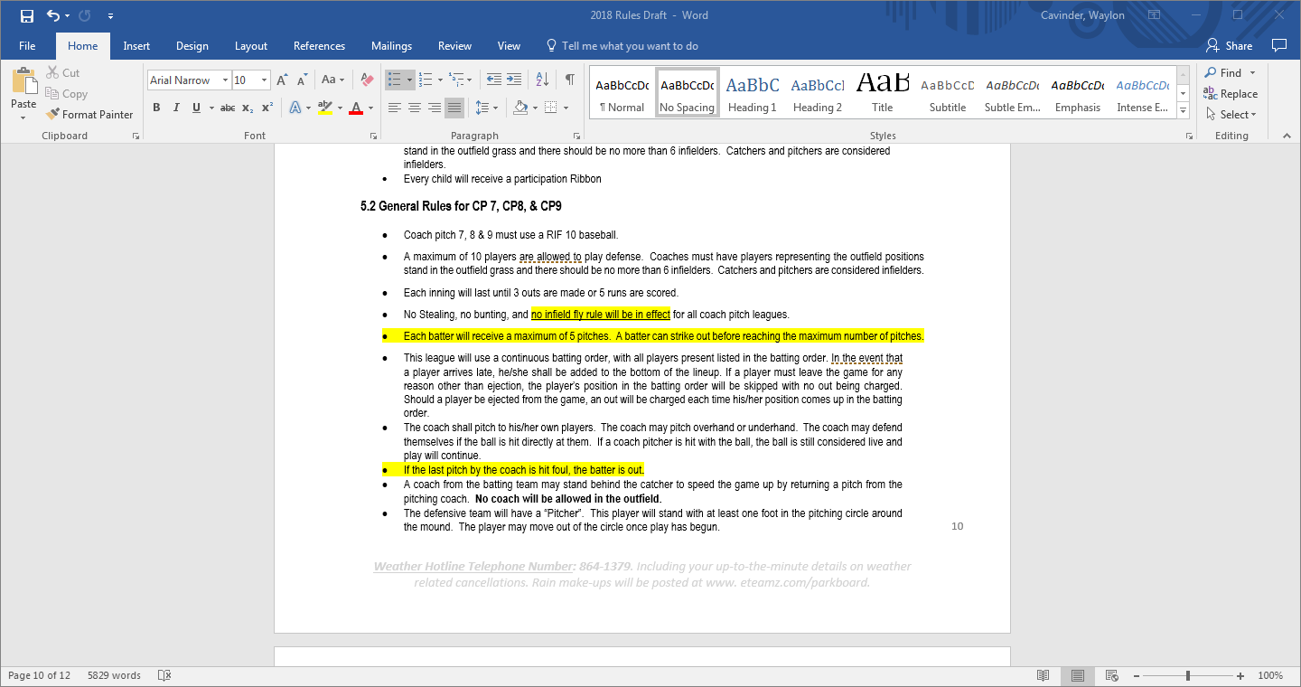
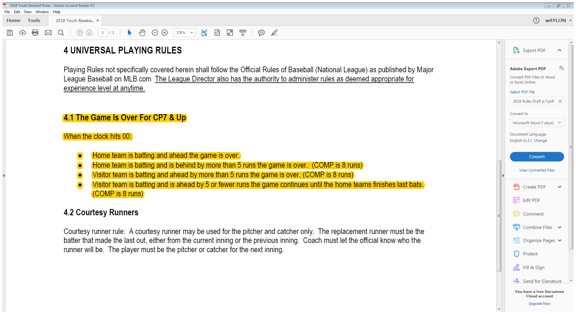
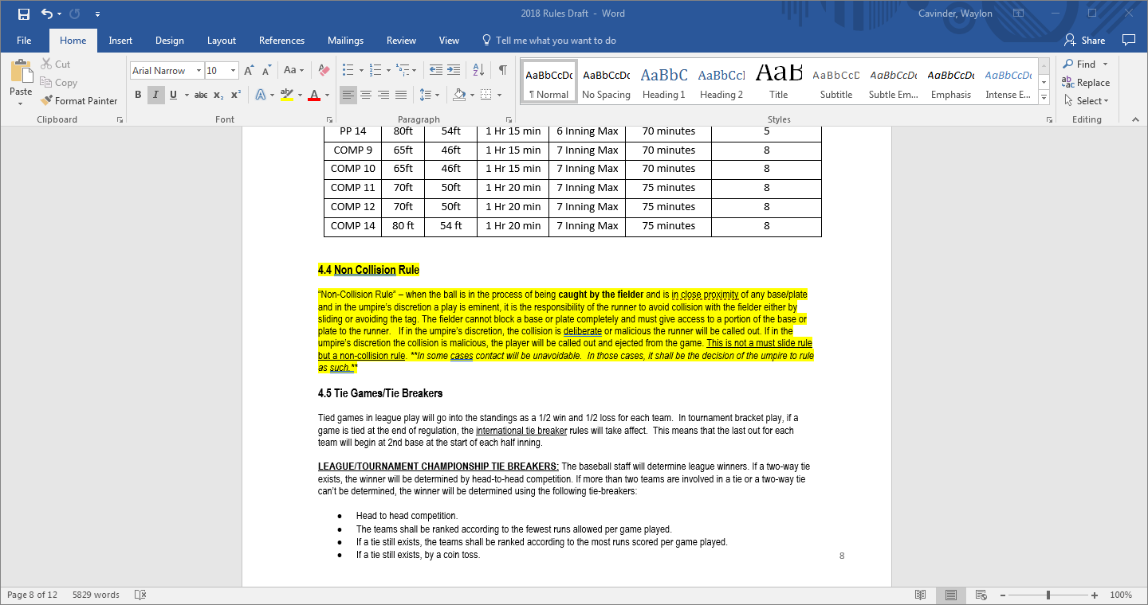
League Specific Rules (Coach Pitch)
Please review your rulebook for a complete guide to Park Board leagues
Games are 55 minutes long and must be played until the clock hits 0
Once the clock hits 0, the game is over if:
Yes…games can end in ties
Non Collision rule
Tball and CP 6 (RIF 5)
CP 7, CP8, and CP9 (RIF 10)
No stealing, no bunting, and no infield fly will be in effect.
Each batter gets 5 pitches
Also no home runs

Slide 11
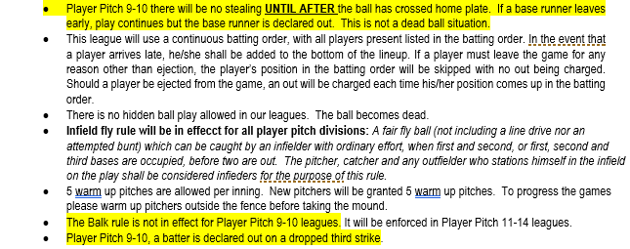
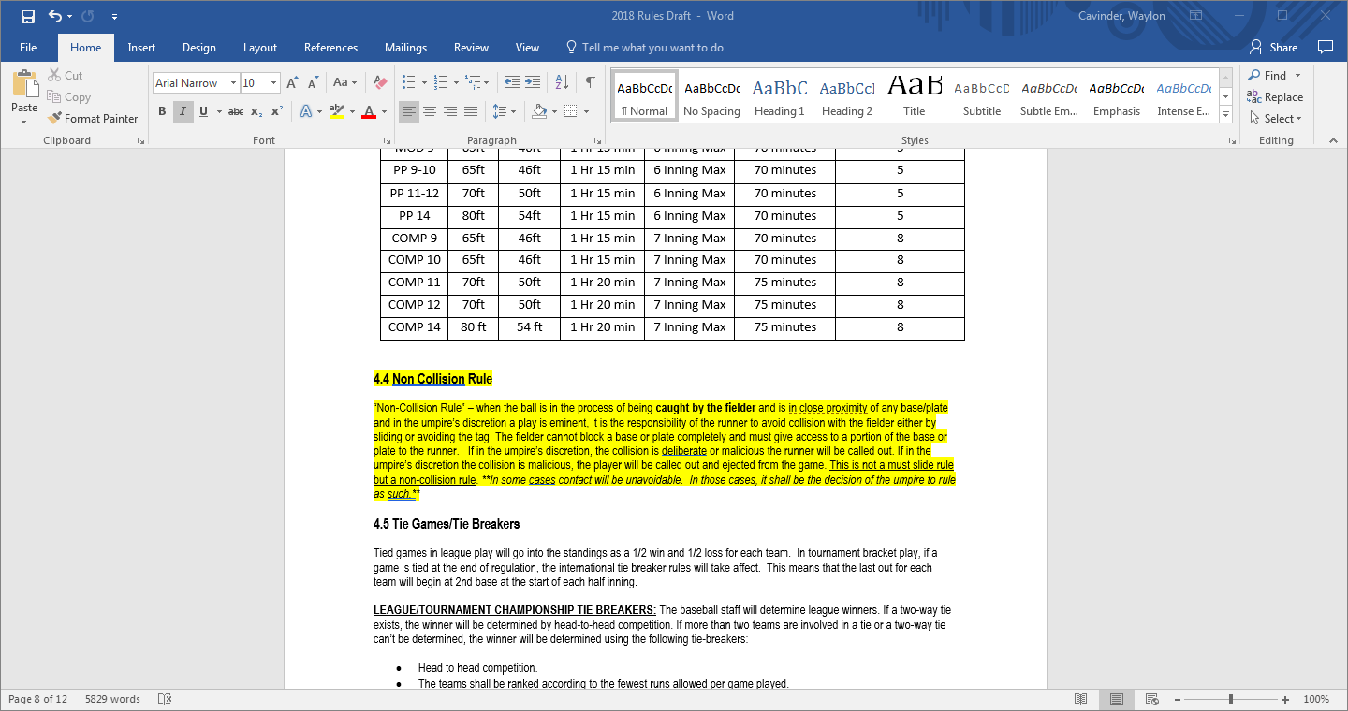
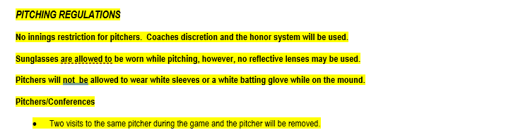
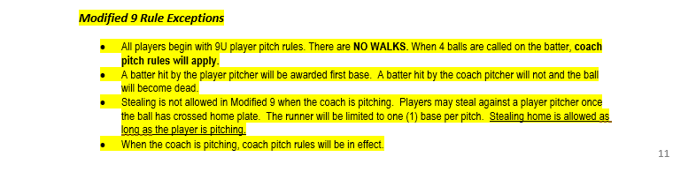
League Specific Rules (Player Pitch)
Please review your rulebook for a complete guide to Park Board leagues
Games are 70 minutes long and must be played until the clock hits 0
Once the clock hits 0, the game is over if:
Yes…games can end in ties
Non Collision rule
Continuous batting order will be used
What are the rules on stealing and leading off?
Infield fly will be in effect for all player pitch divisions
Pitching regulations
PP 9-10 exceptions
MOD 9 exceptions

Slide 12
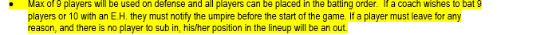
League Specific Rules (Competitive)
Please review your rulebook for a complete guide to Park Board leagues
COMP 9/10 games are 70 minutes long; COMP 11-14 are 75 minutes
Once the clock hits 0, the game is over if:
Yes…games can end in ties
Non Collision rule
What are the rules on stealing and leading off?
Infield fly will be in effect for all competitive divisions
Pitching regulations
8 run max each inning
Batting Lineups

Slide 13
League Schedules
Getting your schedule
Everything is web based this season on our Team Sideline page
Schedules will be made live to view the Wednesday prior to week 1
Making the schedule
No requests are guaranteed, however, if I can make it work I will
If you haven’t put your request on your registration form, there is a good chance you won’t get it. Don’t count on an email request getting processed
I don’t do bye weeks unless there is an odd number in a division…and if you double entered you definitely will not receive a bye week
Once the schedule has been published it will not be altered unless there is a clerical error

